Slide 1
AN INTRODUCTION TO SOFTWARE ENGINEERING
Ing. Svatopluk Štolfa, Ph.D.
prof. Ing Ivo Vondrák, CSc.
Department of Computer Science
Technical University of Ostrava

Slide 2
Objectives
To introduce software engineering and to explain its importance
To set out the answers to key questions about software engineering
To introduce ethical and professional issues and to explain why they are of concern to software engineers
To gain a basic knowledge to become a successful software engineer

Slide 3
References
Pfleeger, Shari Lawrence, and Joanne M. Atlee. 2009. Software Engineering: Theory and Practice: Prentice Hall, ISBN 0136061699.
Pressman, Roger S. 2010. Software Engineering : A Practitioner's Approach. 7th ed. New York: McGraw-Hill Higher Education, ISBN 9780073375977.
Sommerville, Ian. 2010. Software Engineering. 9th ed, International Computer Science Series. Harlow: Addison-Wesley, ISBN 978-0137035151.

Slide 4

What is Software Engineering?
What do you think about the term Software Engineering?
What does it mean to be a software engineer?
What is meant by a “software life-cycle”?
How software projects are planned and managed?
….
Notes:
Since we are going to talk about software engineering it is good to know what it means. Don’t you think?
Are you able to answer these few important questions? What do you think?
Do not worry if you are not sure about the right answer. This is the reason why we are all here. To try to answer these questions, to gain some basic knowledge about a field of study called software engineering and finally, to become a successful software engineer. Ok let’s start.

Slide 5
What is Software Engineering?
Where can you find software?
Software products are large and complex
Development requires analysis and synthesis
Analysis: breaking down a large problem into smaller, better understandable pieces
Abstraction is the key
Synthesis: creating (compose) software from smaller building blocks
composition is challenging
Notes:
Do you think that it is easy to build software? Can you think of some software products?
MS Office, Car computer unit, airplane computer, mobile phone, …
Try to answer this questions:
Aren’t this programs and solutions quite big to do it at once? Where would you start do build such software?
Are you able to code it yourself. How long will it take? Is it not better to cooperate with other people?
Software products are large and complex
Development requires analysis and synthesis
Analysis: break down a large problem into smaller, understandable pieces
abstraction is the key
Synthesis: build (compose) a software from smaller building blocks
composition is challenging

Slide 6
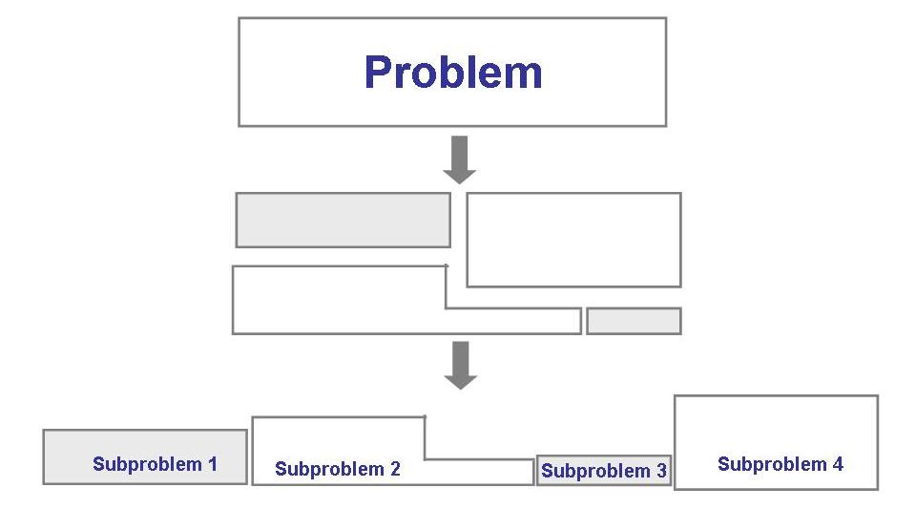
What is Software Engineering?
The analysis process
Notes:
Most problems are large and sometimes tricky to handle. So we must begin investigating the problem by analyzing it. Break it down into pieces that we can understand and try to deal with them. The larger problems can then be described as a collection of small subproblems.

Slide 7
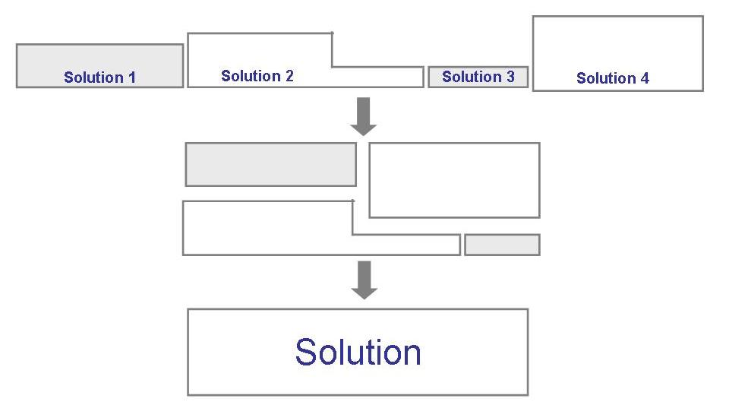
What is Software Engineering?
The synthesis process
Notes:
Once you have analyzed the problem, you must find out the solution to the subproblems. Then the issue it to construct the solution of the large problem that consists of these small subproblems.

Slide 8




What is Software Engineering?
Building a home myself.
Notes:
Let’s imagine that you want to build a home.
Suppose that you get lost in the forest and you have a moment to build some type of a shelter before it gets dark, cold and possibly before it starts to rain. This will give you some small amount of time and you do not need much experience in building houses nor somebody else’s help. In case that your first attempt to pitch a roof fails, there is little damage (unless you let a heavy branch hit your head or break your bones…) and little effort wasted (money or time). You can easily rebuild the shelter in a few minutes. If you are not experienced at all, you will probably need more time and more attempts to finally build something like that. Anyway, you are able to do it yourself.
Next example – the house. Ok, suppose that some of us are able to build the house themselves. Sometimes you ask your friend to do some work for you. Definitely, this way you spend some money to buy building material and you need to plan ahead - what to build, what type of work you need do first, second, next, …
Of course, you can still be in charge of everything and do it yourself.
Next example – the block of flats. Now, you definitely need a plan, more money and more resources – people and materials to accomplish this.
Next example – skyscraper. Can you do it yourself? I don’t think so. No individual can. You might be able to imagine or design its looks, its architecture, draw some basic plans but that’s it. You will definitely need some experienced people to do the rest for you. And I forgot one important thing: you will need a lot of money ;-).
All these examples are metaphors for building software.
The first one – shelter – you want to do your own simple counter, function, that can write some words on the screen etc. Very easy application.
Second one – the house. Let’s imagine for instance an application for your home library, a simple web page etc.
Third one – the block of flats. This could be for instance ERP system for small enterprises, an accounting system, a large web page etc.
Fourth one – the skyscraper. Plane computer software, ERP system for a big company, …

Slide 9
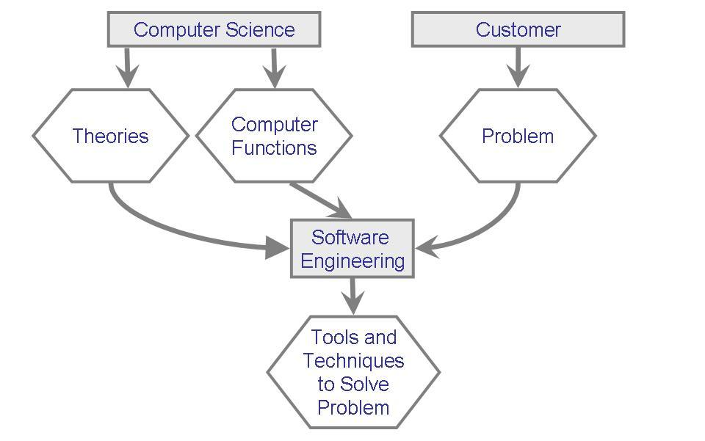
What is Software Engineering
As a software engineer you will use you knowledge of computers and computing to help solve problems.
Notes:
Ok, going back to the Software Engineering - what will YOU do?
As a software engineer you will use you knowledge of computers and computing to help solve problems.
What terms do we need to know to explain this?
Method: refers to a formal procedure; a formal “recipe” for accomplishing a goal that is typically independent of the tools used
Tool: an instrument or automated system for accomplishing something in a better way
Procedure: a combination of tools and techniques to produce a product
Paradigm: philosophy or approach for building a product (e.g., OO vs. structured approaches)
Computer science: focusing on computer hardware, compilers, operating systems, and programming languages
Software engineering: a discipline that uses computer and software technologies as a problem-solving tools
As you can see on the figure, and you are certainly aware of - a computer science is about theories, hardware, functions etc.
On the other hand there is a customer who wants to solve a problem. Customers might not be experienced (they are usually not), in computers and so it is your job to bring the knowledge of computers and the problem together. Finding solution is your domain.
The joining point that tries to combine the problem resolution with computer knowledge is called Software Engineering and the people who do the job are generally called Software Engineers.

Slide 10
Definition of Software Engineering
The IEEE Computer Society (The Institute of Electrical and Electronics Engineers) defines software engineering as:
The application of a systematic, disciplined, quantifiable approach to the development, operation, and maintenance of software; that is, the application of engineering to software.
The study of approaches as in (1).

Slide 11
Definition of Software Engineering
Software engineering is an engineering discipline
concerned with practical problems of developing large software systems.
Software engineering involves:
Technical and non-technical issues
Knowledge of specification, design and implementation techniques
Human factors
Software management

Slide 12
Software Engineering Code of Ethics and Professional Practice 1/2
1. PUBLIC - Software engineers shall act consistently with the public interest.
2. CLIENT AND EMPLOYER - Software engineers shall act in a manner that is in the best interests of their client and employer consistent with the public interest.
3. PRODUCT - Software engineers shall ensure that their products and related modifications meet the highest professional standards possible.
4. JUDGMENT - Software engineers shall maintain integrity and independence in their professional judgment.

Slide 13
Software Engineering Code of Ethics and Professional Practice 2/2
5. MANAGEMENT - Software engineering managers and leaders shall subscribe to and promote an ethical approach to the management of software development and maintenance.
6. PROFESSION - Software engineers shall advance the integrity and reputation of the profession consistent with the public interest.
7. COLLEAGUES - Software engineers shall be fair to and supportive of their colleagues.
8. SELF - Software engineers shall participate in lifelong learning regarding the practice of their profession and shall promote an ethical approach to the practice of the profession.

Slide 14
FAQs about Software Engineering
What is software?
What is software engineering?
What is the difference between software engineering and computer science?
What is the difference between software engineering and system engineering?
What is a software process?
What is a software process model?
Notes:
Let’s try to answer some FAQs about software engineering. Usually, somebody not experienced in the software engineering asks these basic questions:
What is software?
What is software engineering?
What is the difference between software engineering and computer science?
What is the difference between software engineering and system engineering?
What is a software process?
What is a software process model?
And of course, we will learn how to answer them in more detail later in this course.

Slide 15
FAQs about Software Engineering
What are the costs of software engineering?
What are software engineering methods?
What is CASE (Computer-Aided Software Engineering)
What are the attributes of good software?
What are the key challenges facing software engineering?
Notes:
And other questions about more specific things/questions might come to your mind as well.
Let’s try to answer them briefly in this introduction lesson to give you some thoughts and ideas you may find useful in your future careers.
(As) You know, software and computers are not only about playing games. Somebody has to look after those do not know anything about computers and make their jobs and entertainment easier by providing support.
I suppose that you who are sitting here and want to know something about Software Engineering are also those who will challenge the problems of your customers and will lead them to the successful solutions.
Or maybe you just had an idea of developing a similar computer game you used to play in the past because you liked it so much.
Maybe you like computers and just want to help spread out computer-aided solutions and encourage people to use them.
Who knows? It might have something to do with your motivation and your future job.
Let’s continue and answer the questions.

Slide 16
What is Software?
Computer programs and associated documentation such as requirements, design models and user manuals.
Software products may be developed for a particular customer or may be developed for a general market.
Software products may be
Generic - developed to be sold to a range of different customers e.g. PC software such as Excel or Word.
Custom-made (made to order) - developed for a single customer according to their specification.
New software can be created by developing new programs, configuring generic software systems or reusing existing software.
Notes:
Computer programs and associated documentation such as requirements, design models and user manuals.
Software products may be developed for a particular customer or may be developed for a general market.
Software products may be
Generic - developed to be sold to a range of different customers e.g. PC software such as Excel or Word.
Custom-made (made to order) - developed for a single customer according to their specification.
New software can be created by developing new programs, configuring generic software systems or reusing existing software.

Slide 17
What is Software Engineering?
Software engineering is an engineering discipline that deals with all aspects of software production.
Software engineers should adopt a systematic and organised approach to their work and use appropriate tools and techniques depending on the problem to be solved, the development constraints and the resources available.
Notes:
We have already thoroughly discussed the general answer to this question. That a software engineering is solving problems (with the help of) computers, but are there any specific tasks to do?
Software engineering is an engineering discipline that is concerned with all aspects of software production.
Software engineers should adopt a systematic and organised approach to their work and use appropriate tools and techniques depending on the problem to be solved, the development constraints and the resources available.
Analyze the problem, break it down into subproblems, create an architecture of the system to be built, compose the system from scratch. Deliver it to customer.

Slide 18
What is Software Engineering?
The IEEE Computer Society defines software engineering as:
(1) The application of a systematic, disciplined, quantifiable approach to the development, operation, and maintenance of software; that is, the application of engineering to software.
(2) The study of approaches as in (1).

Slide 19
What is the Difference between Software Engineering and Computer Science?
Computer science is concerned with theory and fundamentals; software engineering is concerned with the practicalities of developing and delivering useful software.
Computer science theories are still insufficient to act as a complete underpinning for software engineering (unlike e.g. physics and electrical engineering).
Notes:
You should know the answer to this. Do you memorize it for long term? If not, use the opportunity as a second chance. You know what Software Engineering is – an engineering discipline that helps (to) solve problems of customers from different domains/areas.
Computer science is concerned with theory and fundamentals; software engineering is concerned with the practicalities of developing and delivering useful software.
Computer science theories are still insufficient to act as a complete underpinning for software engineering (unlike e.g. physics and electrical engineering).

Slide 20
What is the Difference between Software Engineering and System Engineering?
System engineering is concerned with all aspects of computer-based systems development including hardware, software and process engineering. Software engineering is part of this process and it is concerned with developing the software infrastructure, control, applications and databases in the system.
System engineers are involved in system specification, architectural design, integration and deployment.
Notes:
Have you ever heard of that term? System engineering? Yes or no? Ok there is the explanation of the difference:
System engineering is concerned with all aspects of computer-based systems development including hardware, software and process engineering. Software engineering is part of this process concerned with developing the software infrastructure, control, applications and databases in the system.
System engineers are involved in system specification, architectural design, integration and deployment.
So, if I would like to let you solve my problem – develop a system for something like a ship. I would not ask you. I would ask a ship-building factory to do that. Anyway, they might then ask you to develop a software for the computers on that ship. Somebody has to deliver a control unit that definitely has some software in it etc.
Ok the boundary between the system and software engineering might not be completely strict. It always depends on the proposed building solution. Sometimes System Engineering might be only the small part of the complete delivery – like in the case of, say accounting software - where you have to deliver PCs and network staff as well, etc.

Slide 21
What is a Software Process?
A set of activities whose goal is the development or evolution of software.
Generic activities in all software processes are:
Specification - what the system should do and its development constraints
Development - production of the software system
Validation - checking that the software is what the customer wants
Evolution - changing the software in response to changing demands.
Notes:
Do you remember that house building example? When we are building a house, do we have to start at some point and end at some point? Why? Because we have to build the house from the basement to the roof (from the ground up). It is obvious that there are tasks that have to be done only after some other tasks are finished. Like, for example, constructing a roof without walls is no use. Of course, sometimes you can do that, but these are rather exceptions.
The same thing works (goes) for the construction of software. It is proven that before you start to build software it is good to ask your customer questions about the software functionality. Then think about the architecture, build components, put them together and test them, deliver the system to the customer etc…
What is a software process?
A set of activities whose goal is the development or evolution of software.
Generic activities in all software processes are:
Specification - what the system should do and its development constraints
Development - production of the software system
Validation - checking that the software is what the customer wants
Evolution - changing the software in response to changing demands.

Slide 22
What is a Software Process Model?
A simplified representation of a software process, presented from a specific perspective.
Examples of process perspectives are
Workflow perspective - sequence of activities;
Data-flow perspective - information flow;
Role/action perspective - who does what.
Generic process models
Waterfall;
Iterative development;
Component-based software engineering.
Notes:
Since the coordination of the work is complicated, sometimes it is useful to use blueprints to control the project. These blueprints model the process.
What is the software process model?
A simplified representation of a software process, presented from a specific perspective.
Examples of process perspectives are
Workflow perspective - sequence of activities;
Data-flow perspective - information flow;
Role/action perspective - who does what.
Generic process models
Waterfall;
Iterative development;
Component-based software engineering.

Slide 23
What are the Costs of Software Engineering?
Roughly 60% of costs are development costs, 40% are testing costs. For custom software, evolution costs often exceed development costs.
Costs vary depending on the type of system being developed and the requirements of system attributes such as performance and system reliability.
Distribution of costs depends on the development model that is used.
Notes:
Money first, of course it is always about money. What is the cost?
Roughly 60% of costs are development costs, 40% are testing costs. For custom software, evolution costs often exceed development costs.
Costs vary depending on the type of system being developed and the requirements of system attributes such as performance and system reliability.
Distribution of costs depends on the development model that is used.

Slide 25
What are Software Engineering Methods?
Structured approaches to software development which include system models, notations, rules, design advice and process guidance.
Model descriptions
Descriptions of graphical models which should be produced;
Rules
Constraints applied to system models;
Recommendations
Advice on good design practice;
Process guidance
What activities to follow.
Notes:
What are software engineering methods?
We have to do the task and activities somehow. How to do that? Use some method. What is a method?
Method is:
Structured approaches to software development which include system models, notations, rules, design advice and process guidance.
Model descriptions
Descriptions of graphical models which should be produced;
Rules
Constraints applied to system models;
Recommendations
Advice on good design practice;
Process guidance
What activities to follow.

Slide 26
What is CASE (Computer-Aided Software Engineering)?
Software systems that are intended to provide automated support for software process activities.
CASE systems are often used for method support.
Upper-CASE
Tools to support the early process activities of requirements and design;
Lower-CASE
Tools to support later activities such as programming, debugging and testing.
Notes:
What is CASE (Computer-Aided Software Engineering)?
You know that we have a computer. Is that right? And you know that software engineering is solving problems using computers. Is that right? Ok so why we should do everything in our engineering field manually. We should be the first who use computers to do the thinking for us. So
Software systems that are intended to provide automated support for software process activities.
CASE systems are often used for method support.
Upper-CASE
Tools to support the early process activities of requirements and design;
Like requirement engineering tools – requisite pro, MS Word, …
Design tools that support graphical view of the problem – UML based tools, …
Lower-CASE
Tools to support later activities such as programming, debugging and testing.
What about programming enviroment – MS Studio, Eclipse, NetBeans? Testing tools, …

Slide 27
What are the Attributes of Good Software?
The software should deliver the required functionality and performance to the user and should be maintainable, dependable and acceptable.
Maintainability
Software must evolve to meet changing needs;
Dependability
Software must be trustworthy;
Efficiency
Software should not make wasteful use of system resources;
Acceptability
Software must be accepted by the users for which it was designed. This means it must be understandable, usable and compatible with other systems.
Notes:
Do you want to build good or bad software?
Of course that you want to build good software..., but
What does it mean to build a good software, how can I recognize good software?
Let’s say that good software:
should deliver the required functionality and performance to the user and should be maintainable, dependable and acceptable.
Maintainability
Software must evolve to meet changing needs;
Dependability
Software must be trustworthy;
Efficiency
Software should not make wasteful use of system resources;
Acceptability
Software must accepted by the users for which it was designed. This means it must be understandable, usable and compatible with other systems.

Slide 28
What are the Key Challenges Facing Software Engineering?
Heterogeneity, delivery and trust.
Heterogeneity
Developing techniques for building software that can cope with heterogeneous platforms and execution environments;
Delivery
Developing techniques that lead to faster delivery of software;
Trust
Developing techniques that demonstrate that software can be trusted by its users.
Notes:
Now, let us think about the software engineering field.
What are the goals that we want to achieve? To build good software easily, quickly.
So the main challenges we face are for example:
Heterogeneity, delivery and trust.
Heterogeneity
Developing techniques for building software that can cope with heterogeneous platforms and execution environments;
Delivery
Developing techniques that lead to faster delivery of software;
Trust
Developing techniques that demonstrate that software can be trusted by its users.

Slide 29
How Can be the Solution Affected by Humans?
Bug – can be a mistake in interpreting a requirement, a syntax error in a piece of code or the yet-unknown be the cause of a system crash
Human error – when human makes a mistake
Fault – when a human makes a mistake performing some software development activity
Failure – the system has some different behavior that was intended by the users
Notes:
Thus, the fault is the inside view of the system – seen by the developers
Failure is an outside view of the system – seen by the users

Slide 30
SWE Knowledge Areas
Software requirements
Software design
Software construction
Software testing
Software maintenance
Software configuration management
Software engineering management
Software engineering process
Software engineering tools and methods
Software quality
Notes:
What are the SWE Knowledge Areas?
To become a successful software engineer you should master or at least know most of this these areas.:
Software requirements – the discipline consist of definitions of the future software
Software design – the discipline that designs the future software
Software construction – the discipline that deals with the programming
Software testing – the discipline that covers the software testing
Software maintenance – the discipline that is the maintenance of the software that is already deployed
Software configuration management – what are the configurations that are running
Software engineering management – the discipline that covers the management of the development
Software engineering process – the discipline that covers processes, their creation, definition, description etc.
Software engineering tools and methods - the discipline that covers tools and development methods
Software quality – the discipline that deals with the quality of the development

Slide 31
Related Disciplines
Computer engineering
Project management
Computer science
Quality management
Management
Software ergonomics
Mathematics
Systems engineering
Notes:
And of course there are many related disciplines that you should know about.
Like Computer engineering - the discipline that describes the construction of the computers
Project management – the discipline that covers the management of the project
Computer science – the discipline that covers the algorithms, methods and tools for the solution of the problems
Quality management – discipline that is about managing the quality of the product and the process
Management – the discipline that describes some basic management stuff
Software ergonomics – the discipline that covers the ergonomic aspects of the software development
Mathematics – the discipline that covers mathematical and logical thinking
Systems engineering – the discipline that covers the knowledge about the whole system building not only the software part of it

Slide 32
Who does Software Engineering?
Customer: the company, organization, or person who pays for the software system
Developer: the company, organization, or person who is building the software system
User: the person or people who will actually use the system
Notes:
Participants in a software development project are: customer, user and developer. Customer sponsors the system and has some needs. Developer builds the system for the customer based on the needs from the customer and from the users. Developer then delivers the system to (the customer’s) users.

Slide 33
What is a System?
A purposeful collection of inter-related components working together to achieve some common objective.
A system may include software, mechanical, electrical and electronic hardware and be operated by people.
System components are dependent on other system components
The properties and behaviour of system components are inextricably inter-mingled

Slide 34
What is Inside and Outside of the System?
Activities and objects
An activity is an event initiated by a trigger
Objects or entities are the elements involved in the activities
Relationships and the system boundaries
A relationship defines the interaction among entities and activities
System boundaries determine the origin of input and destinations of the output
Notes:
What about the system boundary? System does not exists in a vacuum, the hardware and software has to interact with the users or different systems. That interaction defines the boundary of the system.

Slide 35
Building a System
Software system is built in the similar way as the house building.
Requirement analysis
System design
Program design
Implementation
Unit testing
System testing
Delivery
Maintenance
Notes:
Software system is built in the similar way as a house.
Customer defines the needs and maybe the customer is not a direct user, so the user defines needs as well. The need is considered as a requirement. Once requirements are defined, it is necessary to design the system to meet the specified requirements. The design is reviewed then accepted by the customer. Based on the design, the code is written. Once the program is written, it is tested etc. At the end, the final product is delivered to the customer. After the delivery it is possible to do the maintenance (After the delivery - maintenance is taken care of).

Slide 36
Members of the Development Team
Developers:
Project manager
Analyst
Designer
Programmer
Tester
Trainer
Customer
Users
Other stakeholders
Notes:
The typical members of the development team are:
Project manager – responsible for the project management, coordinates the whole team
Analyst – responsible for the requirements gathering and analysis, cooperative to design
Designer – is responsible for the system design, cooperative to program design
Programmer – responsible for the program design and implementation, cooperative to the unit testing
Tester – responsible for the unit testing and integration testing and system testing
Trainer – responsible for the system delivery and maintenance
Customer
User – uses the system, cooperation with developers
These are only the basic roles that are covering the main disciplines of the software development. There might be many other roles that might come. For example – architect – responsible for the architecture design, etc.

Slide 37
Disciplines of the Software Development
Engineering Lifecycle Processes (ISO_IEC_15504):
ENG.01 Requirements Elicitation
ENG.02 System Requirements Analysis
ENG.03 System Architectural Design
ENG.04 Software Requirements Analysis
ENG.05 Software Design
ENG.06 Software Construction
ENG.07 Software Integration
ENG.08 Software Testing
ENG.09 System Integration
ENG.10 System Testing
ENG.11 Software Installation
ENG.12 Software and System Maintenance
Notes:
Disciplines of the Software Development
There are many ways to make software. One way of describing the software development is to divide it into parts – disciplines that do the specific tasks to develop software.
ISO_IEC_15504:
ENG.01 Requirements Elicitation
ENG.02 System Requirements Analysis
ENG.03 System Architectural Design
ENG.04 Software Requirements Analysis
ENG.05 Software Design
ENG.06 Software Construction
ENG.07 Software Integration
ENG.08 Software Testing
ENG.09 System Integration
ENG.10 System Testing
ENG.11 Software Installation
ENG.12 Software and System Maintenance
These disciplines describe the whole software development lifecycle. Of course, there are more disciplines like e.g. project management, but these twelve disciplines are directly related to the development itself. Other disciplines are important too, but are supportive to those basic ones.

Slide 38
Requirements Elicitation
The purpose of the Requirements Elicitation process is to gather, process, and track evolving customer needs and requirements throughout the life of the product and/or service so as to establish a requirements baseline that serves as the basis for defining the needed work products. Requirements elicitation may be performed by the acquirer or the developer of the system.
Notes:
The purpose of the Requirements Elicitation process is to gather, process, and track evolving customer needs and requirements throughout the life of the product and/or service so as to establish a requirements baseline that serves as the basis for defining the needed work products. Requirements elicitation may be performed by the acquirer or the developer of the system.

Slide 39
System Requirements Analysis
The purpose of the System Requirements Analysis process is to transform the defined stakeholder requirements into a set of desired system technical requirements that will guide the design of the system.
Notes:
As a result of successful implementation of the process:
A defined set of system functional and non-functional requirements describing the problem to be solved are established.
The appropriate techniques are performed to optimize the preferred project solution.
System requirements are analyzed for correctness and testability.
The impact of the system requirements on the operating environment are understood.
The requirements are prioritized, approved and updated as needed.
Consistency and traceability is established between the system requirements and the customer’s requirements baseline.
Changes to the baseline are evaluated for cost, schedule and technical impact.
The system requirements are communicated to all affected parties and baselined.

Slide 40
System Architectural Design
The purpose of the System Architectural Design process is to identify which system requirements should be allocated to which elements of the system.
Notes:
As a result of a successful implementation of the process:
A system architecture design is a one that identifies the elements of the system and meets the defined requirements.
The system’s functional and non-functional requirements are addressed.
The requirements are allocated to the elements of the system.
Internal and external interfaces of each system element are defined.
Verification between the system requirements and the system architecture is performed.
The requirements allocated to the system elements and their interfaces are traceable to the customer’s requirements baseline.
Consistency and traceability between the system requirements and system architecture design is maintained.
The system requirements, the system architecture design, and their relationships are baselined and communicated to all affected parties.

Slide 41
Software Requirements Analysis
The purpose of the Software Requirements Analysis process is to establish the requirements of the software elements of the system.
Notes:
As a result of a successful implementation of Software requirements analysis process:
The requirements allocated to the software elements of the system and their interfaces are defined
Software requirements are analyzed for correctness and testability
The impact of software requirements on the operating environment are understood
Consistency and traceability are established between the software requirements and system requirements
Prioritization for implementing the software requirements is defined
The software requirements are approved and updated as needed
Changes to the software requirements are evaluated for cost, schedule and technical impact
The software requirements are baselined and communicated to all affected parties.

Slide 42
Software Design
The purpose of the Software Design Process is to provide a design for the software that implement and can be verified against the requirements.
Notes:
As a result of a successful implementation of the process:
A software architectural design is developed and baselined that describes the software elements that will implement the software requirements.
Internal and external interfaces of each software elements are defined.
A detailed design is developed that describes software units that can be built and tested.
Consistency and traceability are established between software requirements and software design.

Slide 43
Software Construction
The purpose of the Software Construction Process is to produce executable software units that properly reflect the software design
Notes:
As a result of a successful implementation of the process:
Verification criteria are defined for all software units against their requirements.
Software units defined by the design are produced.
Consistency and traceability are established between software requirements and design and software units.
Verification of the software units against the requirements and the design is accomplished.

Slide 44
Software Integration
The purpose of the Software Integration Process is to combine the software units, producing integrated software items, consistent with the software design, that demonstrate that the functional and non-functional software requirements are satisfied on an equivalent or complete operational platform.
Notes:
As a result of a successful implementation of the process:
An integration strategy is developed for software units consistent with the software design and the prioritized software requirements.
Verification criteria for software items are developed that ensure compliance with the software requirements allocated to the items.
Software items are verified using the defined criteria.
Software items defined by the integration strategy are produced.
Results of integration testing are recorded.
Consistency and traceability are established between software design and software items.
A regression strategy is developed and applied for re-verifying software items when a change in software units (including associated requirements, design and code) occur.

Slide 45
Software Testing
The purpose of the Software Testing Process is to confirm that the integrated software product meets its defined requirements.
Notes:
As a result of a successful implementation of the process:
Criteria for the integrated software are developed that demonstrate compliance with the software requirements.
Integrated software is verified using the defined criteria.
Test results are recorded.
A regression strategy is developed and applied for re-testing the integrated software when a change in software items is made.

Slide 46
System Integration
The purpose of the System Integration Process is to integrate the system elements (including software items, hardware items, manual operations, and other systems, as necessary), to produce a complete system that will satisfy the system design and the customers’ expectations expressed in the system requirements.
Notes:
As a result of a successful implementation of the process:
A strategy is developed to integrate the system according to the priorities of the system requirements.
Criteria is developed to verify compliance with the system requirements allocated to the system elements, including the interfaces between system elements.
The system integration is verified using the defined criteria.
A regression strategy is developed and applied for re-testing the system [elements] when changes are made.
Consistency and traceability are established between the system design and the integrated system elements.
An integrated system, demonstrating compliance with the system design and validation that a complete set of useable deliverable system elements exists, is constructed.

Slide 47
System Testing
The purpose of the Systems Testing Process is to ensure that the implementation of each system requirement is tested for compliance and that the system is ready for delivery.
Notes:
As a result of a successful implementation of the process:
Criteria for the integrated system are developed that demonstrate compliance with system requirements.
The integrated system is verified using the defined criteria.
Test results are recorded.
A regression strategy is developed and applied for re-testing the integrated system should a change be made to existing system elements.

Slide 48
Software Installation
The purpose of the Software Installation Process is to install the software product that meets the agreed requirements in the target environment.
Notes:
As a result of a successful implementation of the process:
A software installation strategy is developed.
Criteria for software installation is developed that demonstrates compliance with the software installation requirements.
The software product is installed in the target environment.
Assure that the software product is ready for use in its intended environment.

Slide 49
Software and System Maintenance
The purpose of the Software and System Maintenance process is to modify a system/software product after delivery to correct faults, improve performance or other attributes, or to adapt to a changed environment
Notes:
As a result of a successful implementation of the process:
A maintenance strategy is developed to manage modification, migration and retirement of products according to the release strategy.
The impact of changes to the existing system on organization, operations or interfaces are identified.
Affected system/software documentation is updated as needed.
Modified products are developed with associated tests that demonstrate that requirements are not compromised.
Product upgrades are migrated to the customer’s environment.
On request, products are retired from use in a controlled manner that minimizes disturbance to the customers.
The system/software modification is communicated to all affected parties.

Slide 50
Very Small Enterprises
For the small enterprises or small teams the software implementation consist of:
Software Implementation Initiation
Software Requirements Analysis
Software Design
Software Construction
Software Integration and Tests
Product Delivery
Notes:
We can use a model VSE for the small enterprises or very small development teams. Of course, we are presenting only the development processes.
The software implementation initiation subprocess ensures that the project plan is committed to by the work team.
The software requirements analysis subprocess analyzes the agreed to customer’s requirements and establishes the validated project requirements.
The software architecture and detailed design subprocess transforms the software requirements to the system software architecture and software detailed design.
The software construction subprocess develops the software code and data from the software design.
The software integration and test subprocess ensures that the integrated software components satisfy the software requirements.
The product delivery subprocess provides the integrated software product to the customer.

Slide 51
Software Production Layout
Software Process
Project
instantiated by
Project
Project
consists of
consists of
Project Execution
Analysis
Design
Implementation
Test
Project Management
Planning
Control
uses
uses
Project
Management
Methodology
System of
methods for
software product
development
System of
methods for
project
management
Software
Development
Methodology
is a
is a
Notes:
Software Production Layout.
What is necessary to produce a software. We have already talked about the disciplines. Now, we have to talk about an ordering of the disciplines. The basic ordering is described by the process. Since we are developing software - software process. We can think of a process as a set of ordered tasks. It means series of steps involving activities, constraints, and resources that produce an intended output of some kind. In our case a software system.

Slide 52
A Definition of Process
W. Humphrey and P. Feiler: "A process is a set of partially ordered steps intended to reach a goal..."(to produce and maintain requested software deliverables). A software process includes sets of related artifacts, human and computerized resources, organizational structures and constraints.
B
A
D
C
Relationships
of all tasks (workflow)
PROCESS
Skills,
Training,
Motivation, &
Management
Tools
Notes:
A Definition of Process
A process usually involves a set of tools, techniques, relationships.
Any process has the following characteristics:
The process prescribes all the major process activities.
The process uses resources, subject to a set of constraints, and produce intermediate and final product.
The process may be composed of subprocesses that are linked in some way. The process may be defined as a hierarchy of processes, organized so that each subprocess has its own model.
Each process activity has entry and exit criteria, so we know when the activity starts and ends.
The activities are organized in a sequence, so that it is clear when one activity is performed relative to the other activities.
Every process has a set of guiding principles that explain a goal of each activity.
Constrains and controls may apply to an activity, resource or product.

Slide 53
Software Process Models I
The reasons to model a software process:
If the description of the development process is written down, it forms a common understanding of the activities, resources and constrains involved in the software development process
The creation of the process model helps the team to find inconsistencies, redundancies and omissions in the process. As the problems are solved the process becomes more effective and focused on the development of the final product
Notes:
Why to model a software development process?
The reasons to model a software process:
If the description of the development process is written down, it forms a common understanding of the activities, resources and constrains involved in the software development process
The creation of the process model helps the team to find inconsistencies, redundancies and omissions in the process. As the problems are solved the process becomes more effective and focused on the development of the final product

Slide 54
Software Process Models II
The reasons to model a software process:
The model should reflect the goals of the development – building a high quality software system, finding faults in early stages of the development, meet the required budget, follow the prescribed schedule. When the model is built, the team may go through it and check whether all necessary components are there, or support some.
Each project has its process tailored. Every project is special. Software Process Development Model helps the team to understand where that tailoring is to occur.

Slide 55
The Waterfall Process Model
Requirements
Analysis and
Definition
System and
SW Design
Implementation
(Coding)
Testing and
Maintenance
Notes:
One of the first proposed models was the Waterfall Model. As the figure implies, the previous development stage should be completed before the next phase begins. Requirements are elicited from the customer and analyzed. System architecture is developed and the modules are designed. Then the system is implemented. After that the system goes to testing, it is installed and maintained. The model is easy to understand and describes all necessary prescriptions for the software development process.

Slide 56
The Waterfall Model: Problems
It takes too long to see results: nothing is executable or demonstrable until code is produced.
It depends on stable, correct requirements.
It delays the detection of errors until the end.
It does not promote software reuse.
It does not promote prototyping.
...
Notes:
The Waterfall Model: Problems
It takes too long to see results: nothing is executable or demonstrable until code is produced.
It depends on stable, correct requirements.
It delays the detection of errors until the end.
It does not promote software reuse.
It does not promote prototyping.
The biggest problem is that the model does not reflect the way in which the code has been developed. Unless the problem is very well understood, the software is usually developed in iterations.
That is (also) the main issue that the model cannot solve. Of course, there is a simple solution to that but it is provided by other models.

Slide 57
The Software Development Process in Reality
System and
SW Design
Requirements
Analysis and
Definition
Implementation
(Coding)
Testing and
Maintenance
Notes:
The Software Development Process in Reality
If the developers use a simple waterfall model or do not use a model at all, the reality might look messy. In reality the software development process is a mess, the developer switches from one discipline to another. The process is uncontrolled and the developers try to do what they think is (the) best for the progress. The result is a complete mess (chaos). They try to gather some requirements, once they get them they attempt to design, they realize that the design need some repair of previously written code, that code must be redesigned etc.

Slide 58
Exploratory Programming
Develop
outline
specification
Build software
system
Use software
system
NO
System
adequate?
YES
Deliver
software system
Notes:
Exploratory Programming
Exploratory programming might be one of the solutions. Of course, this approach is a very abstract and describes only the very basics. The idea is that the specification is developed and after that a system is built. When the system is built somebody uses or tests it and answers the question whether it does what it should (what it is supposed to). If not, the system is rebuilt until it does what is expected by the user or tester. This approach is something like a predecessor of the prototyping approach. Prototyping will be explained later.

Slide 59
Waterfall Model with a Prototyping
Requirements
Analysis and
Definition
System and
SW Design
Implementation
(Coding)
Prototyping
Testing and
Maintenance
Notes:
Waterfall Model with a Prototyping
One of the easiest solutions to the “reality” problem is to introduce a prototyping to the waterfall development process. The software is made in small steps. The prototype is made in every stage – discipline, the prototype is evaluated and then if the prototype does what was expected from that part of the system, the next one is added. If not, the prototype is being rebuilt until appropriate solution is found. Then the other functionality is added.

Slide 60
Prototyping Model
List of Revisions
List of Revisions
List of Revisions
Prototype Requirements
Prototype Design
Prototype System
Test
Delivered System
System Requirements
Notes:
Prototyping model.
We have presented the way the waterfall model can be connected to the prototyping model in the previous slide. On the other hand the prototyping model can itself be a base for a good process model. The model is based on the fact that the requirements are implemented as soon as possible and the result is seen very quickly. Requirements are elicited, then the design of the prototype is made and the system is implemented. Every discipline is revised until the result is acceptable to all customers, users and developers.

Slide 61
V Model
Validate Requirements
Requirement Analysis
Acceptance Testing
Verify Design
System Design
System Testing
Program Design
Unit and Integration Testing
Coding
Notes:
The V model.
The V model is a variation to the waterfall model. The V model is based on testing. Testing is used to verify and validate all development test. The requirement analysis is validated by the acceptance testing, it means the users and customers test that the delivered system really does what it should do. The system testing verifies the design of the system. System testing is made by the developer to test whether all components that were made are connected correctly and the system works as planned. Unit and integration testing is made for the components and the integration of the components.

Slide 62
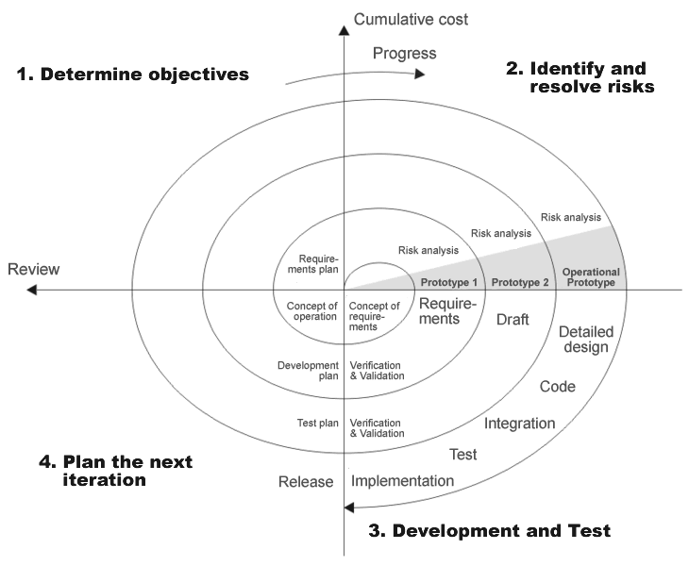
Spiral Model
Notes:
Spiral Model.
Spiral model is based on the iterative development. The spiral starts with the requirements and the plan of the project and iteration and requirements plan. The concept is evaluated. The principle works for all types of disciplines. The first result and prototype is a concept, the second prototype are requirements, the third prototype is a software design and the next prototype is a detailed design. The concept is also based on the risks evaluation. For example, if the designer is not sure whether the user will like the type of GUI, they might prototype it and run a test of what is preferred.

Slide 63
Agile Methods
Opposite to the strictly formulated methodologies
Agile manifesto – emphasis on the roles and flexibility
They value individuals and interactions over processes and tools – it means supply the developer with the resources and then trust them to do their job
They prefer to invest the effort for producing real software than producing the documentation.
They focus (more) on the customer collaboration than the negotiation of the contract. The customer is involved in the development process more than in the requirements phase
They concentrate on the responding to the change not creating the whole plan. They believe that it is impossible to gather and implement all requirements at the beginning. New or changed requirements will appear during the development.

Slide 64
Extreme Programming (XP)
Set of techniques to emphasize the creativity of developers and minimize the administration
Extreme Programming is based on 12 principles:
The Planning Process -- Quickly determine the scope of the next release by combining business priorities and technical estimates. As reality overtakes the plan, update the plan.
Small Releases -- The software is developed in small stages that are updated frequently, typically every two weeks.
Metaphor -- Guide all development with a simple shared story of how the whole system works.
Simple Design -- The software should include only the code that is necessary to achieve the desired results communicated by the customer at each stage in the process. Extra complexity is removed as soon as it is discovered.
Testing -- Testing is done consistently throughout the process. Programmers design the tests first and then write the software to fulfill the requirements of the test. The customer also provides acceptance tests at each stage to ensure the desired results are achieved.
Refactoring -- XP programmers improve the design of the software through every stage of development instead of waiting until the end of the development and going back to correct flaws.
Pair Programming -- All code is written by a pair of programmers working at the same machine.
Collective Ownership -- Anyone can change any code anywhere in the system at any time.
Continuous Integration -- The XP team integrates and builds the software system multiple times per day to keep all the programmers at the same stage of the development process at once.
40-Hour Week -- The XP team does not work excessive overtime to ensure that the team remains well-rested, alert and effective.
On-Site Customer -- The XP project is directed by the customer who is available all the time to answer questions, set priorities and determine requirements of the project.
Coding Standard -- The programmers all write code in the same way. This allows them to work in pairs and to share ownership of the code.

Slide 65
Crystal
Is based on the fact that every project needs a different set of polices, conventions and methodologies. Crystal is based on people’s trust
People largely influence the quality of the software. The quality of the projects and processes improve as the quality of the people involved increases.
Productivity increases through better communication and frequent delivery. There is less need for intermediate products.

Slide 66
Adaptive Software Development
Has six basic principles
Mission that acts as a guideline – setting up a goal but do does not prescribe how to get there
Customer value – futures are viewed through the customer value
The project is organized around building a components around the features
Iteration is important – change is not viewed as a correction but as an adjustment to the reality of the software development.
Fixed delivery times – force the developers to plan the scope of an iteration
Risk is embraced – the developers tackle the hardest problems first

Slide 67
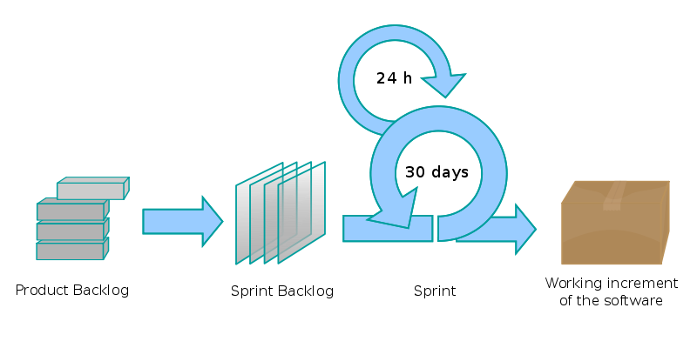
SCRUM
Notes:
SCRUM
SCRUM is iterative software development process that is considered as an agile approach.
Scrum is based on the principles of extreme programming and extends them. SCRUM can be used for the development of the process, maintenance of the process or software management.
The main principles of scrum are:
There is no manager in the usual sense.
Team activities are controlled by the SCRUM Master.
Team is involved in the planning.
Tasks are not assigned to the team members. Team members take them themselves.
15 minutes scrum meeting every day.

Slide 68
SCRUM Roles
A pig and a chicken are walking down a road. The chicken looks at the pig and says, "Hey, why don't we open a restaurant?" The pig looks back at the chicken and says, "Good idea, what do you want to call it?" The chicken thinks about it and says, "Why don't we call it 'Ham and Eggs'?" "I don't think so," says the pig, "I'd be committed but you'd only be involved."
Notes:
This joke is describe the basic idea of the scrum - there are two types of role groups – those who are committed and those that are only involved.
Pigs – scrum master, project owner, team. Chickens – users, stakeholders, managers

Slide 69
SCRUM Meetings
Daily SCRUM
During the actual sprint, 15-20 minutes
Sprint planning meeting
Before each sprint, limit 8h
Sprint review meeting
At the end of the sprint, system previews, limit 4h
Sprint retrospective
Feedback from the sprint, answers
What was done correctly
What could be done better
Notes:
There are several types of scrum meetings. Those meetings are held at the specific times and for a limited amount of time. For example the best daytime to do the daily scrum is a morning, when everybody starts his work or is at the end of previous work or in the middle of the problem. Everyone shares the information with (the) others. Sometimes the team members need some help from other team members.
Daily SCRUM
During the actual sprint, 15-20 minutes
Sprint planning meeting
Before each sprint, limit 8h
Sprint review meeting
At the end of the sprint, system previews, limit 4h
Sprint retrospective
Feedback from the sprint, answers
What was done correctly
What could be done better

Slide 70
SCRUM Artifacts
Product backlog
High level document that describes the whole product
What should the system do, requirements etc.
Sprint backlog
Detailed document that describes the information about the current sprint.
Burn down
Is a public document that shows the work to be done in the sprint.
Notes:
Scrum Artifacts
There are three basic scrum artifacts. The basic one is the product backlog that contains the requirements and the description what the software should do. Team selects the subset of the requirements set from this document and describes it in more detail in the sprint backlog. The tasks are described in the burn down document.

Slide 71
Symptoms of Software Development Problems
Inaccurate understanding of end-user needs
Inability to deal with changing requirements
Modules don’t integrate
It is difficult to maintain or extend the software
Late discovery of flaws
Poor quality and performance of the software
No coordinated team effort
Build-and-release issues
Notes:
Let’s see the other development processes the so called rigid processes, why they started.
When the software system was developed, many project had some of these symptoms. When the symptom appeared the solution could be found but the roots of such a symptom must be treated (addressed) not the result.
Symptoms of Software Development Problems
Inaccurate understanding of end-user needs
Inability to deal with changing requirements
Modules don’t integrate
It is difficult to maintain or extend the software
Late discovery of flaws
Poor quality and performance of the software
No coordinated team effort
Build-and-release issues

Slide 72
Root Causes
Insufficient requirements specification and their ad hoc management
Ambiguous and imprecise communication
Brittle architecture
Overwhelming complexity
Undetected inconsistencies in requirements, design, and implementation
Poor and insufficient testing
Subjective assessment of project status
Failure to attack risk
Uncontrolled change propagation
Insufficient automation
Notes:
To treat these root causes eliminates the symptoms and enables to develop and maintain software in a repeatable and predictable way.

Slide 73
Software Best Practices
Commercially proven approaches to software development that, when used in combination, strike at the root causes of software development problems.*
Develop software iteratively
Manage requirements
Use component-based architectures
Visually model software
Verify software quality
Control changes to software
Notes:
Techniques exist that are proved to be commercially successful in eliminating the problems arising from root causes. When these best practices are followed the root causes are solved and no symptoms should occur.

Slide 74
Tracing Symptoms to Root Causes and Best Practices
Inaccurate understanding of end-user needs
Inability to deal with changing requirements
Modules don’t integrate
It is difficult to maintain or extend the software
Late discovery of flaws
Poor quality and performance of the software
No coordinated team effort
Build-and-release issues
Insufficient requirements specification and their ad hoc management
Ambiguous and imprecise communication
Brittle architecture
Overwhelming complexity
Undetected inconsistencies in requirements, design, and implementation
Poor and insufficient testing
Subjective assessment of project status
Failure to attack risk
Uncontrolled change propagation
Insufficient automation
Develop software iteratively
Manage requirements
Use component-based architectures
Visually model software
Verify software quality
Control changes to software

Slide 75
Develop Software Iteratively
Classic software development processes follow the waterfall lifecycle. Development proceeds linearly from requirements analysis, through design, implementation, and testing.
It takes too long to see results.
It depends on stable, correct requirements.
It delays the detection of errors until the end.
It does not promote software reuse and prototyping.
Requirements
analysis
Software Design
Implementation (Coding)
Testing and Deployment

Slide 76
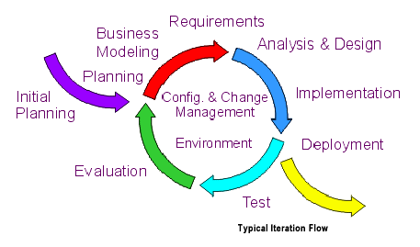
Iterative and Incremental Process
This approach is one of continuous discovery, invention, and implementation, with each iteration forcing the development team to drive the desired product to closure in a predictable and repeatable way.
Notes:
An iteration is a complete development loop resulting in a release (internal or external) of an executable product, a subset of the final product under development, which grows incrementally from iteration to iteration to become the final system.

Slide 77
Solutions to Root Causes
Serious misunderstandings are made visible early
This approach enables user feedback
The development team is forced to focus on most critical issues
Continuous testing enables an objective assessment of the project status
Inconsistencies among requirements, design, and implementation are detected early
The workload of the team is spread more evenly during project lifecycle
The team can leverage lessons learned and improve the process
Stakeholders can be given concrete evidence of the project status

Slide 78
Manage Requirements
A requirement is a condition or capability a system must have.
It is a real problem to capture all requirements before the start of development. Requirements change during project lifecycle. Understanding and identifying of requirements is a continuous process.
The active management of requirements is about following three activities: eliciting, organizing, and documenting the system required functionality and constraints.

Slide 79
Solutions to Root Causes
A disciplined approach is built into requirements management
Communication is based on defined requirements
Requirements have to be prioritized, filtered, and traced
An objective assessment of functionality is possible
Inconsistencies are detected more easily
With a tool support it is possible to provide a repository for system requirements

Slide 80
Use Component-Based Architectures
Component-Based Development is an important approach allowing to build resilient software architecture because it enables the reuse of components from many available sources. Components make reuse possible on a larger scale, enabling systems to be composed from existing parts, off-the-shelf third-party parts, and a few new parts that address the specific domain and integrate the other parts together.
Iterative approach involves the continuous evolution of the system architecture. Each iteration produces an executable architecture that can be measured, tested, and evaluated against the system requirements.

Slide 81
Solutions to Root Causes
Components facilitate resilient architectures
Modularity enables a clear separation of system elements that are subject to change
Reuse is facilitated by leveraging standardized frameworks (COM, CORBA, EJB …) and commercially available components
Components provide a natural basis for configuration management
Visual modeling tools provide automation for component-based development

Slide 82
Visually Model Software
A model is a simplification of reality that completely describes a system from a particular perspective.
Class
Diagrams
Use-Case
Diagrams
Object
Diagrams
Static
Diagrams
Sequence
Diagrams
Collaboration
Diagrams
Component
Diagrams
Models
Deployment
Diagrams
Statechart
Diagrams
Dynamic
Diagrams
Activity
Diagrams
Visual Modeling with UML

Slide 83
Solutions to Root Causes
Use cases and scenarios unambiguously specify behavior
Software design is unambiguously captured by models
Details can be hidden when needed
Unambiguous design discovers inconsistencies more readily
Application quality begins with good design
Visual modeling tools provide support for UML modeling

Slide 84
Continuously Verify Software Quality
Software problems are exponentially more expensive to find and repair after deployment than beforehand.
Verifying system functionality involves creating test for each key scenario that represents some aspect of required behavior.
Since the system is developed iteratively every iteration includes testing = continuous assessment of product quality.
Cost
Time

Slide 85
Testing Dimensions of Quality
Functionality
Test the accurate workings of each usage scenario
Supportability
Usability
Test the ability to maintain and support application under production use
Test application from the perspective of convenience to end-user.
Performance
Reliability
Test online response under average and peak loading
Test that the application behaves consistently and predictably.

Slide 86
Solutions to Root Causes
Project status assessment is made objective because test results are continuously evaluated
This objective assessment exposes inconsistencies in requirements, design and implementation
Testing and verification is focused on most important areas
Defects are identified early and thus the costs of fixing them are reduced
Automated testing tools provide testing for functionality, reliability, and performance

Slide 87
Control Changes to Software
The ability to manage change - making certain that each change is acceptable, and being able to track changes - is essential in an environment in which change is inevitable.
Maintaining traceability among elements of each release is essential for assessing and actively managing the impact of change.
In the absence of disciplined control of changes, the development process degenerates rapidly into chaos.

Slide 88
Solutions to Root Causes
The workflow of requirements changes is defined and repeatable
Change requests facilitate clear communication
Isolated workspaces reduce interferences among team members working in parallel
Workspaces contain all artifacts, which facilitates consistency
Change propagation is controlled
Changes can be maintained in a robust system

Slide 89
The Rational Unified Process
The Rational Unified Process® (RUP) is a Software Engineering Process. It provides a disciplined approach to assigning tasks and responsibilities within a development organization. Its goal is to ensure the production of high-quality software that meets the needs of its end-users, within a predictable schedule and budget.
RUP is a process product. It is developed and maintained by Rational Software and integrated with its suite of software development tools available from IBM.
RUP is a process framework that can be adapted and extended to suit the needs of an adopting organization.
RUP captures many of best practices mentioned before (develop software iteratively, manage requirements, use component-based architectures, visually model software, continuously verify software quality, control changes to software).

Slide 90
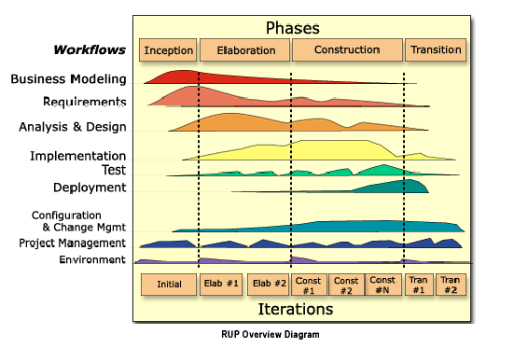
Two Dimensions of the Process
Notes:
Two Dimensions of the Process
The rational unified process consist of phases – dynamic aspect of the process and workflows – static aspect of the process.
Static aspect of the process: how it is described in terms of activities, artifacts, workers and workflows – organization along content
Dynamic aspect of the process as it is enacted: it is expressed in terms of cycles, phases, iterations, and milestones – organization along time
Static structure of the process describes who is doing what, how, and when. The RUP is represented using following primary elements:
Roles: the who
Activities: the how
Artifact: the what
Workflow: the when
A discipline is the collection of above mentioned kinds of elements.

Slide 91
Cycles and Phases
Each cycle results in a new release of the system, and each is a product ready for delivery. This product has to accommodate the specified needs.
The development cycle is divided in four consecutive phases
Inception: a good idea is developed into a vision of the end product and the business case for the product is presented.
Elaboration: most of the product requirements are specified and the system architecture is designed.
Construction: the product is built – completed software is added to the skeleton (architecture)
Transition: the product is moved to user community (beta testing, training …)

Slide 92
Iterations
Each phase can be further broken down into iterations. An iteration is a complete development loop resulting in a release (internal or external) of an executable product, a subset of the final product under development, which grows incrementally from iteration to iteration to become the final system.

Slide 93
Static Structure of the Process
A process describes who is doing what, how, and when using following modeling elements:
Workers (Roles) define the behavior and responsibilities of an individual (designer, analyst, programmer ...), or a group of individuals working together as a team.
Artifacts are things that are produced, modified, or used by a process (model, document, source code …).
Activities are performed by workers to create or update some artifacts (review design, compile code, perform test …).
Workflows are sequences of activities that produce results of observable value (business modeling, implementation …).

Slide 94
Roles
Role defines the behavior and responsibilities of an individual (designer, analyst, programmer ...), or a group of individuals working together as a team.
The behavior is expressed in terms of activities the role performs, and each role is associated with a set of cohesive activities.
The responsibilities of each role are usually expressed in relation to certain artifact that the role creates, modifies, or controls.
Roles are not individuals, nor job titles. One can play several roles in the process.

Slide 95
Activities
An activity is a unit of work that an individual in that role may be asked to perform and that produces a meaningful result in the context of the project.
The granularity of an activity may vary from hours to days. It usually involves one person in the associated role and affects one or only small number of artifacts.
Activities may be repeated several times on the same artifact, especially from one iteration to another.

Slide 96
Artifacts
Artifacts are things that are produced, modified, or used by a process (model, document, source code, executables …).
Deliverables are only the subset of other artifacts.
Artifacts are very likely to be subject to version control and configuration management.
Sets of Artifacts:
Management set – planning and operational artifacts
Requirements set – the vision document and requirements in the form of stakeholders’ needs
Design set – the design model and architecture description
Implementation set – the source code and executables, the associated data files
Deployment set – installation instructions, user documentation, and training material

Slide 97
The Unified Modeling Language
The Unified Modeling Language (UML) is a standard language for writing software blueprints.
The UML may be used to visualize, specify, construct and document the artifacts of a software-intensive system.
Visualizing means graphical language
Specifying means building precise, unambiguous, and complete models
Constructing means that models can be directly connected to a variety of programming languages

Slide 98
Building Blocks of the UML
UML
Things
Relationships
Diagrams
Grouping
Use case
Object
Class
Interface
Component
Node
Dependency
Association
Generalization
Realization
Use case
Class
Sequence
Collaboration
Statechart
Activity
Component
Deployment
Package
Subsystem
Model
http://www.uml.org

Slide 99
Core Engineering Workflows
Business Modeling describes the structure and dynamics of the organization
Requirement describe the use case-based method for eliciting requirements
Analysis and Design describe the multiple architectural views
Implementation takes into account sw development, unit test, and integration
Test describes test cases and procedures
Deployment covers the deliverable system configuration

Slide 100
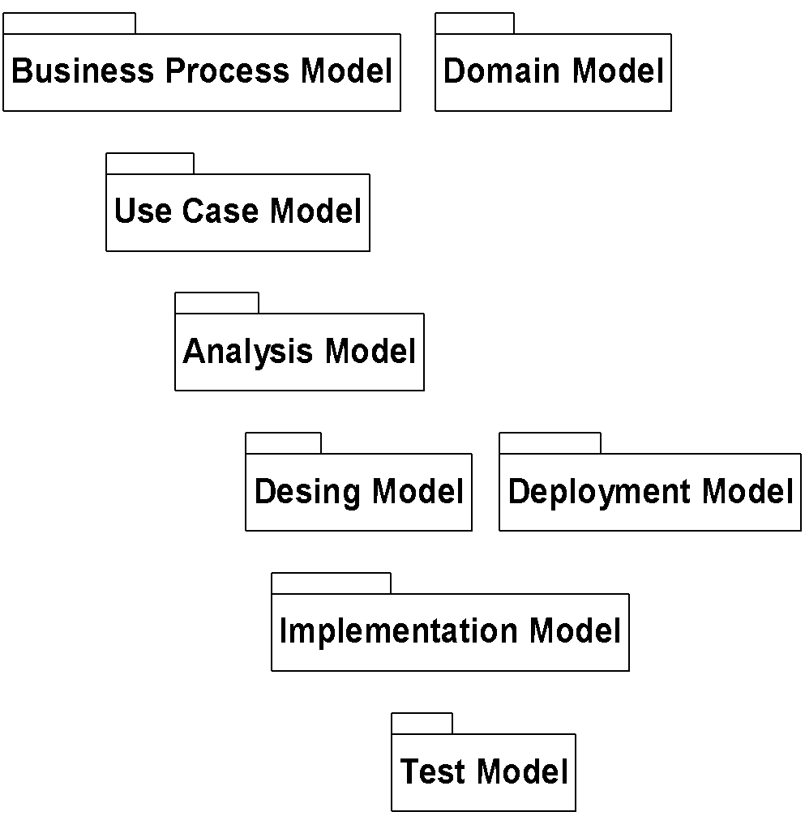
Workflows and Models
Business Modeling
UML diagrams provide views into each model
Requirements
Analysis
Design
Implementation
Test
Each workflow is associated with one or more models

Slide 101
Core Supporting Workflows
Configuration Management describes how to control the numerous artifacts produced by the many people who work on a common project (simultaneous update, multiple versions …).
Project Management is the art of balancing competing objectives, managing risk, and overcoming constraints to deliver, successfully, a product which meets the needs of both customers (the payers of bills) and the users.
Environment Workflow provides the software development organization with the software development environment—both processes and tools—that are needed to support the development team.

Slide 102
PROCESS STANDARDS
Notes:
In this part, we are going to speak about process standards. Several software development processes have been described so far. What is the common background for these processes or what rules should these processes follow? Obviously, standards started as a set of good practices that were recognized in the usage of the processes. Companies that created or followed these processes made an expert group that formulated the key issues that the processes should cover. On the other hand, when you try to define a new process, that process should follow all these best practices.

Slide 103
ISO/IEC Integrated set of Standards
ISO/IEC 15504
Capability
ISO/IEC 12207 ISO/IEC 15288
Life Cycle
ISO 9001 &
ISO 9000-3
Quality
Notes:
There are many standards that can influence or be taken into an account during the development of the new software. Now, we are going to speak only about a small set of them. That set of standards is covering the development processes and prescribes the necessary things to do. These standards are:
ISO/IEC 12207 -Systems and Software Engineering — Software Life Cycle Processes is an international standard for software lifecycle processes. It aims to be the standard that defines all the tasks required for developing and maintaining software.
ISO 15288 - Systems and Software Engineering -- System life cycle processes - is a System Engineering standard covering processes and life cycle stages.
ISO/IEC 15504 Information technology — Process assessment, also known as SPICE (Software Process Improvement and Capability Determination), is a set of technical standards documents for the computer software development process and related business management functions.
ISO 9001:2008 Quality management systems

Slide 104
ISO/IEC 15504 Process Assessment Standard
International Standard 15504 (formerly known as SPICE)
Part 1: Concepts and Vocabulary
Part 2: Performing an Assessment
Part 3: Guidance on Performing an Assessment
Part 4: Guidance on Use for Process Improvement and Process Capability Determination
Part 5: An exemplar Process Assessment Model
Part 6: An Exemplar System Life Cycle Process Assessment Model (based on 15288)
Part 7: Organizational Maturity Assessment

Slide 105
Part 2 Scope
The requirements for process assessment defined in this international standard form a structure which:
Facilitates self-assessment;
Provides a basis for use in process improvement and capability determination;
Takes into account the context in which the assessed process is implemented;
Produces a process rating;
Addresses the ability of the process to achieve its purpose;
Is applicable across all application domains and sizes of organization;
May provide an objective benchmark between organizations.

Slide 106
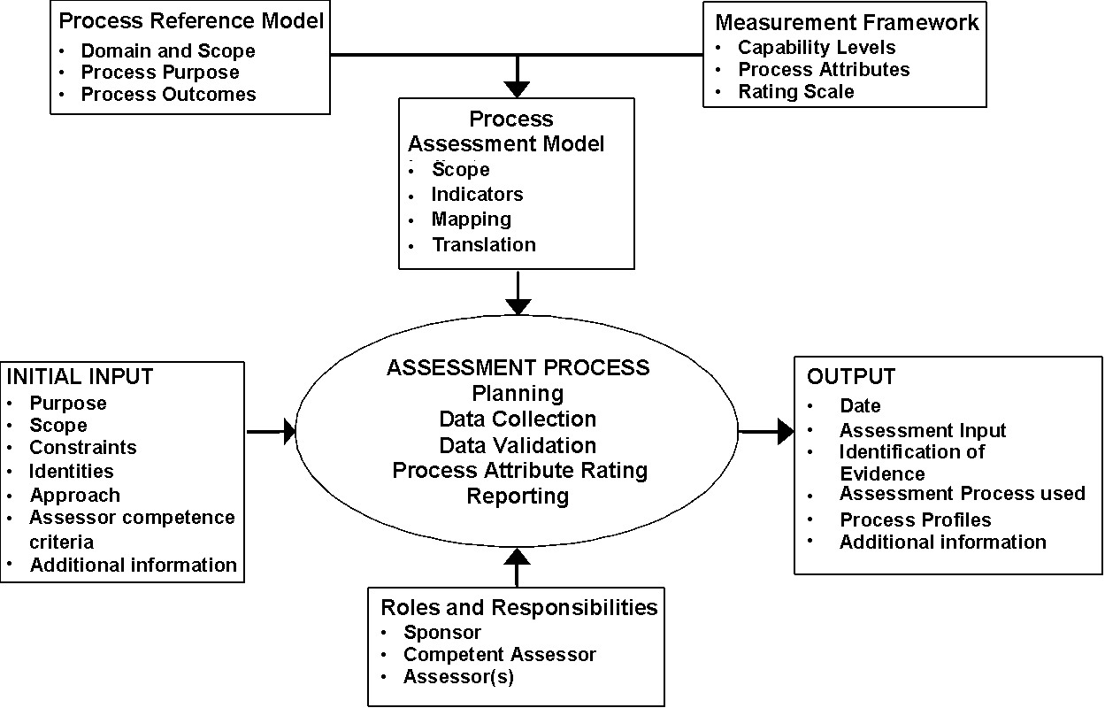
Part 2 Normative Elements

Slide 107
Process Attributes
Process Attribute ID | Capability Levels and Process Attributes
 | Level 0: Incomplete process
 | Level 1: Performed process
PA 1.1 | Process performance
 | Level 2: Managed process
PA 2.1 | Performance management
PA 2.2 | Work product management
 | Level 3: Established process
PA 3.1 | Process definition
PA 3.2 | Process deployment
 | Level 4: Predictable process
PA 4.1 | Process measurement
PA 4.2 | Process control
 | Level 5: Optimizing process
PA 5.1 | Process innovation
PA 5.2 | Continuous optimization

Slide 108
Process Attribute Rating Scale - NPLF
N Not achieved | There is little or no evidence of achievement of the defined attribute in the assessed process. | 0 to 15%
P Partially achieved | There is some evidence of an approach to, and some achievement of, the defined attribute in the assessed process. Some aspects of achievement of the attribute may be unpredictable. | > 15 to 50%
L Largely achieved | There is evidence of a systematic approach to, and significant achievement of, the defined attribute in the assessed process. Some weakness related to this attribute may exist in the assessed process. | > 50 to 85%
F Fully achieved | There is evidence of a complete and systematic approach to, and full achievement of, the defined attribute in the assessed process. No significant weaknesses related to this attribute exist in the assessed process. | > 85 to 100%

Slide 109
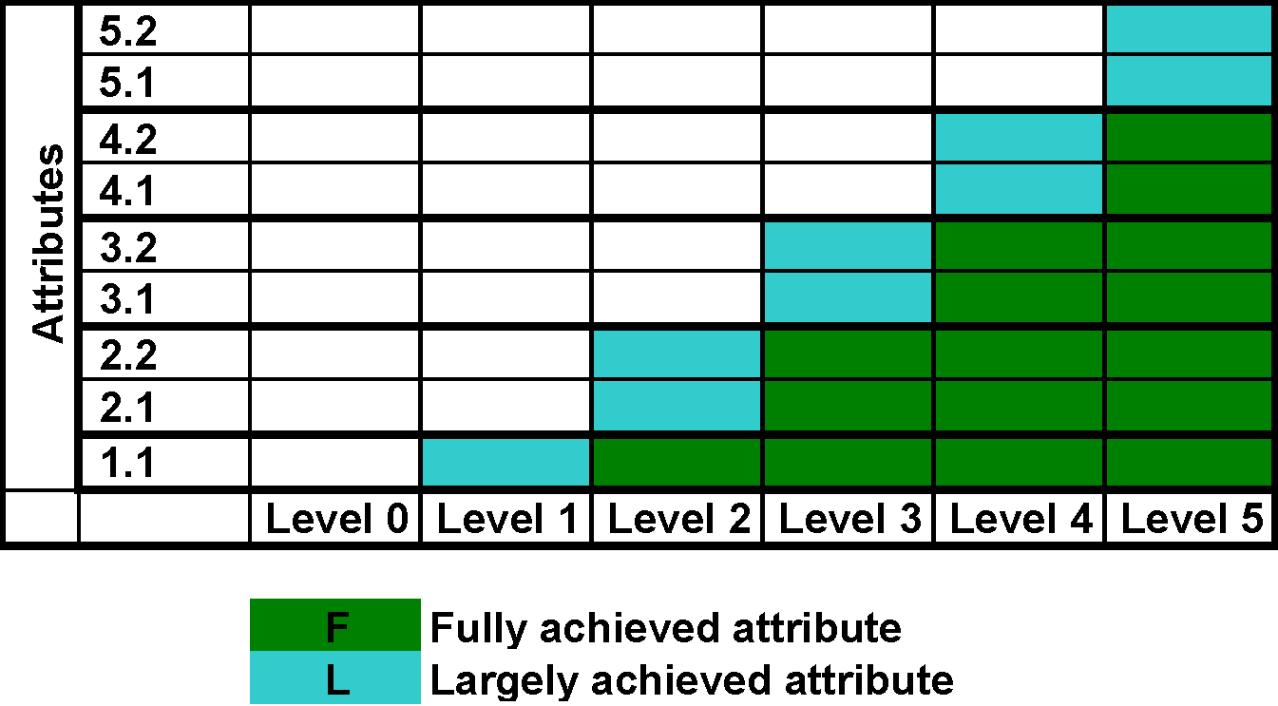
Achievement of Process Capability Levels
Notes:
The ratings for a process instance can be converted into a single capability level for the process instance.
This must be done according to the algorithm defined in the standard.
The capability level is derived according to the graph on the slide.
To achieve a capability level, the process instance must be rated as fully achieving all the attributes at the lower levels, and largely achieving the attributes at that level.

Slide 110
Part 5: The Process Assessment Model
ISO/IEC 15504-5
ISO/IEC JTC1 SC7 WG10
Defines a Process Assessment Model that meets the requirements of ISO/IEC 15504-2 and that supports the performance of an assessment by providing indicators for guidance on the interpretation of the process purposes as defined in ISO/IEC 12207 AMD 1 & AMD 2 and process attributes defined in ISO/IEC 15504‑2;
Provides guidance, by example, on the definition, selection and use of assessment indicators.

Slide 111
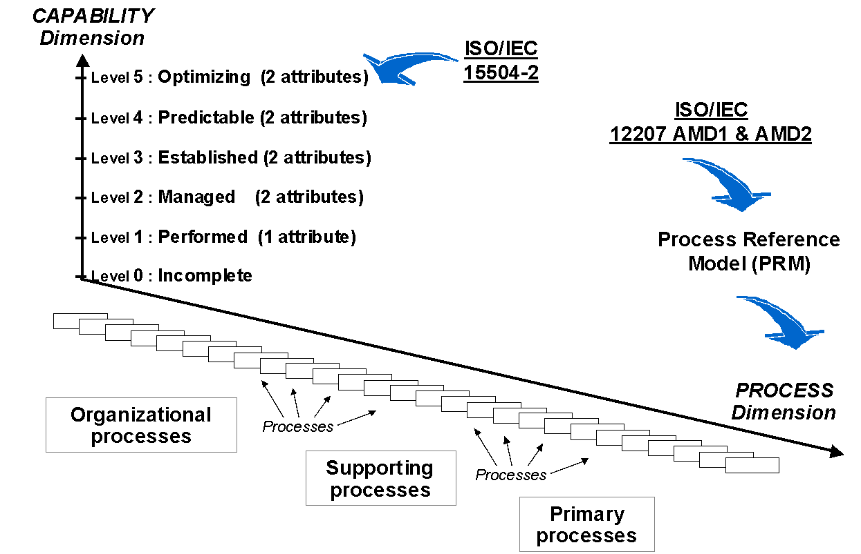
Process Assessment Model (PAM)
© ISO/IEC
Notes:
Process assessment model provides a level of detail that ensures consistent assessment results. The process reference model alone cannot be used as the basis for conducting reliable and consistent assessments of process capability since the level of detail is not sufficient.
Process assessment model is needed to form the basis for the collection of evidence and rating of process capability. Any process assessment model must provide at least two dimensional view of process capability. In one dimension it describes a set of process entities that relate to the process defined in the specific Process Reference Model – Process dimension. In the other dimension, the model describes the capabilities that relate to the process capability levels and process attributes defined in ISO/IEC 15504-2 – capability dimension.

Slide 112
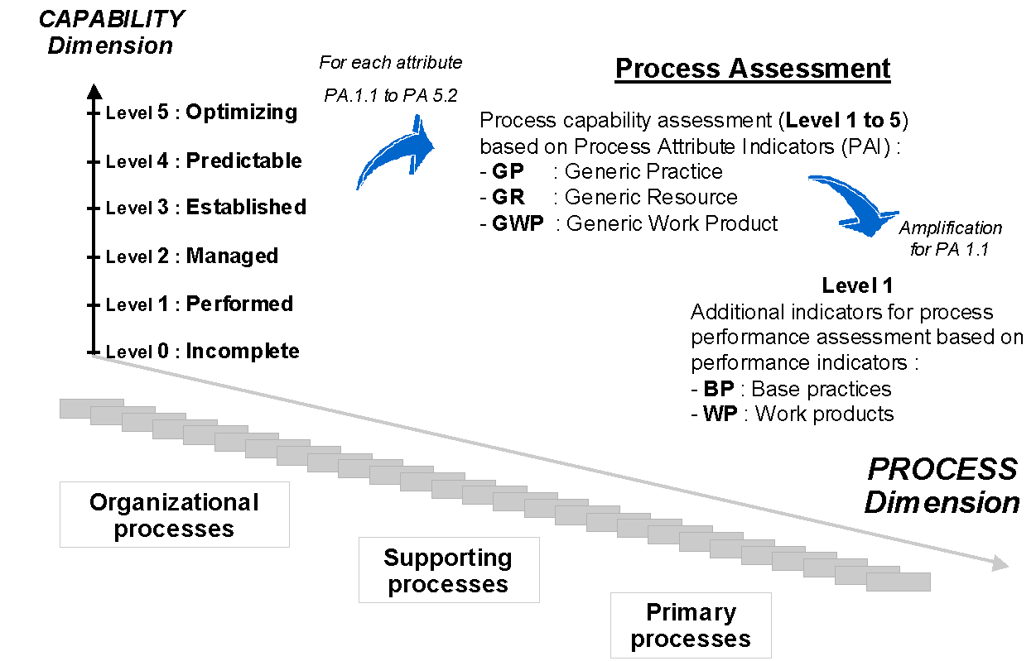
Capability Dimension
© ISO/IEC
Notes:
Indicators
A process assessment model must document a set of indicators of process performance and process capability that enable judgments of process capability. The assessment indicators represent various types of objective evidence that might be found when the process is used.
There are two sets of indicators:
Factors that indicate the performance of the process. – provides coverage for the purposes and outcomes of the process
Factors that indicate the capability of the process – provide coverage for the process attributes at the various capability levels.

Slide 113
Process Dimension
PRIMARY Life Cycle Processes
Acquisition Process Group (ACQ)
Supply Process Group (SPL)
Engineering Process Group (ENG)
Operation Process Group (OPE)
ORGANIZATIONAL Life Cycle Processes
Management Process Group (MAN)
Process Improvement Process Group (PIM)
Resource and Infrastructure Process Group (RIN)
Reuse Process Group (REU)
SUPPORTING Life Cycle Processes
Supporting Process Group (SUP)
© ISO/IEC

Slide 114
Primary
1. Acquisition Group - ACQ
ACQ.1 Acquisition preparation
ACQ.2 Supplier selection
ACQ.3 Contract agreement
ACQ.4 Supplier monitoring
ACQ.5 Customer acceptance
2. Supply Group - SPL
SPL.1 Supplier tendering
SPL.2 Product release
SPL.3 Product acceptance support
3. Operation Group - OPE
OPE.1 Operational use
OPE.2 Customer support
4. Engineering Group - ENG
ENG.1 Requirements elicitation
ENG.2 System requirements analysis
ENG.3 System architecture design
ENG.4 Software requirements analysis
ENG.5 Software design
ENG.6 Software construction
ENG.7 Software integration
ENG.8 Software testing
ENG.9 System integration
ENG.10 System testing
ENG.11 Software installation
ENG.12 Software and system maintenance

Slide 115
Organizational
6. Management Group - MAN
MAN.1 Organizational alignment
MAN.2 Organization management
MAN.3 Project management
MAN.4 Quality management
MAN.5 Risk management
MAN.6 Measurement
7. Process Improvement Group - PIM
PIM.1 Process establishment
PIM.2 Process assessment
PIM.3 Process improvement
8. Resource and Infrastructure Group - RIN
RIN.1 Human resource management
RIN.2 Training
RIN.3 Knowledge management
RIN.4 Infrastructure
9. Reuse Group - REU
REU.1 Asset management
REU.2 Reuse program management
REU.3 Domain engineering

Slide 116
Supporting
5. Supporting Process Group - SUP
SUP.1 Quality Assurance
SUP.2 Verification
SUP.3 Validation
SUP.4 Joint Review
SUP.5 Audit
SUP.6 Product Evaluation
SUP.7 Documentation
SUP.8 Configuration Management
SUP.9 Problem Resolution Management
SUP.10 Change Request Management

Slide 117
Guidance for Rating I
We have already described the overall principles in assigning NPLF-ratings to process attributes.
Most of the findings should fall in P and L classes.
N is used when there is practically no evidence of performing the activity.
F is used when the activity is completely performed i.e. no problems are related to it.
Often inexperienced assessors tend to be too critical in the assessment. The point in self-assessment is to find possibilities for improvement, not to blame individuals or projects.

Slide 118
Guidance for Rating II
For example, considering the first task of Software Requirements Analysis activity, rating could be based on the following findings:
Tasks have not been assigned and roles are unclear -> N
Some tasks are assigned, but not defined in the project plan -> P
Most tasks are assigned according to roles, but the project plan is not updated -> L
All tasks are assigned according to roles and project plan -> F
Task | Input | Output | NPLF | Notes
SI.2.1 Assign tasks to the work team members in accordance with their role roles, based on the current Project Plan. | Project Plan [reviewed] |  | P | Project plan not updated (weakness); Define roles for project personnel (improvement).

Slide 119
Interpreting Assessment Results
The assessment results of tasks or activities can be aggregated simply by looking at the average of the rating. The assessor should also pay attention to the overall purpose of the assessed process or activity. Following examples present an aggregate of a set of ratings:
P,F,F -> overall L
F,L,F -> overall F
N,P,P,L,L -> overall P
L,L,N,N,P,L -> overall P
F,L,P,P,P,P -> overall P or L (based on assessor's judgment)
Notes:
If the overall assessment result is Fully achieved, we should reward the project team and ensure that the experiences of the assessed process instance are utilized in other projects. Attention to possible findings and improvement opportunities should be given.
If the process purpose is Largely achieved, we need to ensure that the improvement ideas are properly addressed and necessary resources to plan and implement the improvements are reserved.
If the result is Not achieved or Partially achieved, we need to make sure that the process is understood correctly and plan actions to establish or rework the process with adequate resources and knowledge. For example, in case of software requirements analysis process,
low capability imposes a serious risk to the VSE business; additional information can be found in Deployment Package – Software Requirements Analysis.

Slide 120
Part 6: An Exemplar System Life Cycle Process Assessment Model
To define an exemplar system life cycle process assessment model compliant with ISO/IEC 15504 Part 2. This will establish an authoritative, international approach to system life cycle process assessments, that are trustworthy and consistent across business domains and cultural diversity.
This assessment model will be a Technical Report Type 2 within the current ISO/IEC 15504 Multipart set and will use ISO/IEC 15288:2002 as the system life cycle process reference model.

Slide 121
Part 7: Assessment of Organizational Maturity
The scope includes the current scope of ISO/IEC 15504. This addition to the International Standard addresses the expression of the results of assessment of processes in terms of the overall maturity of an organizational unit, and the application of the results of assessment of organizational maturity for process improvement and capability determination.
It defines the conditions under which the results of conformant assessments of process capability can be translated into expressions of organizational maturity, ensuring that the results are objective, impartial, consistent, repeatable and representative of the assessed organizational units.

Slide 122
Life Cycle Models
ISO 12207
ISO/IEC 12207:1995 Software Life Cycle Processes
Amendment (2001); Annex F – normative
Amendment to ISO/IEC TR15504-2 - Reference Model Extensions For Acquirer Processes
ISO 15288
ISO/IEC 15288:2002 System Life Cycle Processes
Notes:
ISO 12207
The primary lifecycle processes contain the core processes involved in creating a software product. These processes are divided into five different main processes:
Acquisition
Supply
Development
Operation
Maintenance
ISO 15288
The standard defines processes divided into four categories:
Technical
Project
Agreement, and
Enterprise
Each process is defined by a purpose, outcomes, and activities.

Slide 123
ISO/IEC 20000
Service Management
Based on IT Infrastructure Library (ITIL)
ISO/IEC DIS 20000-1, IT service management -- Part 1: Specification for service management
the requirements for an organization to deliver managed services of an acceptable quality for its customers.
ISO/IEC DIS 20000-2, IT service management -- Part 2: Code of practice for service management
IT service management processes
Planned Part 3: Scoping guidelines
Prepare an organization for certification
All parts to be harmonized with other process standards
Process descriptions
Assessments based on 15504

Slide 124
VSE
Software Life Cycle Profiles and Guidelines for use in Very Small Enterprises (VSE)
New set of standards and guidelines to be developed to support use of existing standards
Work started in 2005
Process implementation model
Based on MoProSoft (Mexico)
Expressed in sets of profiles
Provides path for small organizations
To implement life cycle models and
To use assessments for process improvement
To demonstrate process capability
To achieve ISO9000
http://profs.logti.etsmtl.ca/claporte/English/VSE/index.html

Slide 125
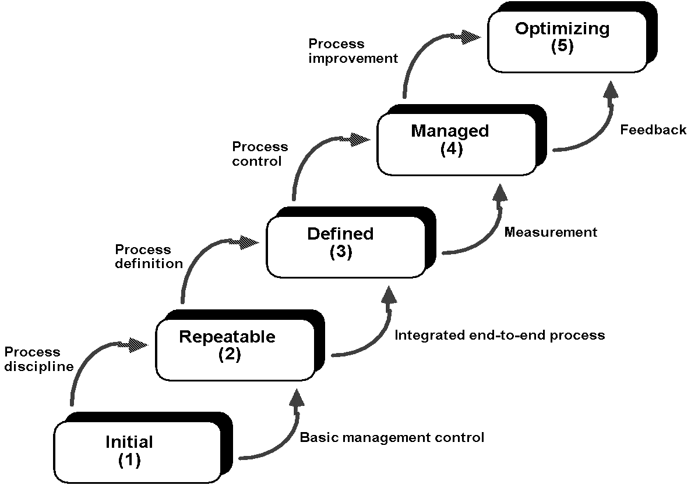
Maturity Levels
Notes:
Maturity Levels
Once again how to understand to the maturity capability levels? There is even the zero level – not performed process - no process is performed at all, everything is made ad-hoc. The first step is initial, there are some task performed, but not controlled.
Second step is a repeatable process, the process is followed somehow and there exists some basic management control.
Third step is a defined process – standard process is and there exists the guidance how to apply the process for every type of project.
Fourth level means, that the process is accurately controlled and measured.
Fifth level – Optimizing – means that there are controlled feedbacks from the process that might lead to the improvement of the standard process.

Slide 126
Visibility Into the SW Process
1
In
Out
2
In
Out
3
In
Out
4
In
Out
5
In
Out
Notes:
Visibility Into the SW Process
Each level of the maturity capability says something about the process:
Level 1 – Initial – the process is not known exactly, there are only known inputs and outputs.
Level 2 – Repeatable – the process is known, but consists of black boxes that are not measurable, but it is possible to measure the whole process.
Level 3 – Defined – the process is known, each part is clear and measurable
Level 4 – Managed – There might be a part of the process measured, not the whole disciplines.
Level 5 – Optimizing – Process improvement is taken into account when necessary.

Slide 127
REQUIREMENTS
Notes:
Requirements
In the next part, we are going to speak about requirements. The part will consist of requirements gathering, problems with the requirements gathering, models and tool to do the requirement analysis.

Slide 128

We have implemented all your needs
Yes, but ii is not what I wanted
Notes:
Many developers already experienced that the development of the project did not have to be only a complete success, but there might be many problems during the development of the software project.
These problems might even lead to a failure of the project or its rejection his reject by the customer.
The causes for this failure can make up a long list of possible problems.
It is well known that the successful handover of the software system is a big issue in the software engineering area.
Let’s have a look at four main symptoms that might lead to the problems.
Symptom no. 1.
Analyst or developer of the software project omits the important task that leads to the understanding of the customer needs. Analysts or developers think that they understand all the needs at once and want to implement them immediately.

Slide 129
Why you didn’t tell us that you want this requirement?
You did not ask me. I thought that you knew everything. It is your fault.
Notes:
Symptom no. 2.
Software system requirements that are derived from the customer need were not described carefully, the stakeholders were not involved to the process of requirement definition. The developers or analysts were too selfish or thought that they knew what the customer needed. The customer does not know that the developer or analyst does not understand his/her needs. How could he understand? He probably does not know anything about the software development process. It is completely the fault of the developers (developers’ fault).

Slide 130

I think that this requirement means this….
Notes:
Symptom no. 3.
The developers think that they know everything. The requirements are not formally described and there is no change management. If they have to implement the requirement that is not completely clear they do it their way, they do not consult the problem with the analyst or customer. The problem is that the developers might not understand all customers intentions with this requirement and the connection to other requirements if it is not described.

Slide 131

I have a new great requirement. That requirement must be implemented now.
Sure, no problem…
Notes:
Symptom no. 4.
The project is not managed correctly. Nobody knows or cares about the time management, nobody cares about the difficulty of the requirements. Customer changes requirements, brings new requirements and the developers do not know the difficulty. The problem is that the project might soon ravage the project budget or the time consuming requirements might take too much time to built the complete project on time.

Slide 132
What are the Requirements for?
Problem
Problem Domain
Needs
Solution domain
Requests
Traceability
Software Requirements
Product to be built
Test Procedures
User Documentation
Design
Notes:
What are the requirements for?
Requirements management consists of the analysis of customers’ needs. These needs are transformed to the software requirements. These software requirements are then divided into functional and non-functional requirements.
According to the requirements, the test procedures are made, design is made to satisfy the requirements, user documentation etc.
The pyramid shows the process that started in the problem domain, where the problem was defined, then the needs of the new software, requests that are derived from these needs, software requirements that are derived from the request and then the rest of the artifacts. The pyramid shows that the needs and requests are the core things that have to be solved, everything else relies on them.

Slide 133
Definition of the Software Requirement
Requirement
Condition or the capability of the system that the system has to satisfy
Requirement management
The systematic approach to the:
Gathering, selection, organization and definition of the requirements.
Creation of the process and method for the customers and developers that enables to change the requirements in a controlled way
Notes:
Now, we have to ask a question, what is the requirement.
Requirement is a capability or a condition that the system has to satisfy.

Slide 134
Definition of the Software Requirement II
Requirement
is a needed function, property or behavior of the system
Types of requirements
Directly connected to the customer
System needs
Legislative needs
Etc.
Notes:
It is not important whether the requirements are gathered directly from the customers or they are defined in the various documents that have been signed with the customer, specification of the software requirement or other formally approved document.
According to the UML, the requirement is a needed function, property or behavior of the system.
Anyway, a requirement specifies WHAT the system should do, but does not describe HOW to do that.
There are many types of requirements.
For example, requirements ruled by a function are directly connected to the customer, on the other hand, legal requirements are requirements that specify the legislative need that has to be followed by the system.
You have to know that it is not possible to define all requirements at once at the beginning of the project.
Requirement management is successful only when the requirements are briefly described at the beginning and then completely detailed.

Slide 135
What does the Software Requirement Specify?
Inputs
Outputs
System
Design conditions
Functionality
Non functional requirements
(e.g. )
Notes:
What does the software requirement specify?
As was already mentioned before, a requirement describes the condition or the capability that the system has to satisfy. Software requirements are in fact something like a description of the black box. Requirements define only the externally visible things WHAT the system should do.
Sometimes there are necessary descriptions HOW the system should specifically do that. These descriptions are defined by the design conditions.

Slide 136
Definition of Terms
User Request
Description of the customer needs without the connection to the specific solution
Property
Externally visible service that that satisfies the stakeholder needs
Software Requirement
Functional Requirement
Requirement that specifies how the solution to be implemented interacts with the surrounding world from the “black box” view
Non-Functional Requirement
Requirement that defines the quantitative attributes of the solution, again from the “black box” view
Condition
Condition of the design or the process of the software development

Slide 137
Definition of Terms – Example – University System
User request
Reduction of the administrative load
Teachers need immediate access to the students results
Property
Information about students will be accessible from the semester view or from the group view.
Software requirement
Functional requirement
When the student selects “subject registration” the system will show all available subjects
Non-functional requirement
The system will be accessible 99% of the time 24/7 (the system might not be available only 3,65 days per year)
Condition
The system will run on the current mainframe university architecture.

Slide 138
Requirements Exist on Many Levels
Stakeholder needs
WHAT
HOW
Product or system requirements
WHAT
HOW
Software requirements
WHAT
HOW
Design specification
Test procedures
Documentation
Notes:
Requirements exist on many levels
It depends on the perspective whether it is a requirement or a design condition.
For example, the stakeholder request is a requirement for the system analyst. Analyst creates a product or a system, requirements that are inputs to the software requirements.
Software requirements that are described by the use cases must specify what the system should do to satisfy the requested functionality.
The person responsible for the creation of the use cases creates a set of these use cases that are requirements for the system designers. The same principle continues.
When we want to develop a system that satisfies stakeholder needs, it is important to correctly understand all the needs. Therefore, the quality of requirements is very important during the whole development process.

Slide 139










Requirement Management is not an Easy Task
Requirements:
Are not always clear.
They come from many sources.
It might not be easy to describe them.
Are connected together.
Have a unique properties or values.
Are changing.
It is hard to follow so many requirements...
Notes:
Requirement Management is not an Easy Task
Requirements management might looks like an easy task, but it is not. The realization of the requirement management is hard task.
There are many reasons like:
Customers not always know what they want
When the number of requirements grows it is not easy to follow them all and take them in into account.
It can be hard to recognize the dependency between the requirements
IT people have a problem to use a style of writing that is understandable to non-technical people.
All possible problems can be overcome by the right selection of the process.

Slide 140
It is Important to Have a Strategy
SR plan
Notes:
It is important to have a strategy.
It is important to have a requirement management plan. Requirement management plan specifies control mechanisms that are used for the gathering, description, measurement and management of the software requirements.
It is important to know how the requirements will be documented and organized. It is necessary to know how the requirements will be managed for the whole project lifecycle.
Requirement management plan describes then all important decisions that are concerning description of the requirements, methods a strategies for the gathering of the requirements, traceability of the requirements, etc.
Similarly to the glossary, that describes the terminology of the project, the requirements management plan is a life document. This document is created at the beginning of the project and then extended according to the timeline of the important decisions.

Slide 141
What is in the Requirements Management Plan
RMP consists of
Types of the requirements that will be gathered
Where the requirements will be stored and how the requirements will be described
Attributes that are necessary to follow
Types of the requirements that are necessary to follow
Types of the documents that will be created
Rules for the requirements management plan
SR Plan
Notes:
Requirement management plan should be prepared as a template document in the company. Then, the document RMP is accustomed for every single project that needs that.

Slide 142
Effective Requirement Management
Management and clear definition of the requirements by the
Well described requirements
Attributes usable for every type of the requirement
Dependability of the requirements, relationships with other requirements
The goal is to deliver quality requirements, on time, according to the budget and satisfy the real customer needs.
Notes:
Effective Requirement Management
Management and clear definition of the requirements by the
Well described requirements
Attributes usable for every type of the requirement
Dependability of the requirements, relationships with other requirements
The goal is to deliver quality requirements, on time, according to the budget and satisfy the real customer needs.
Management

Slide 143

What is Quality Product?
Quality is to:
Satisfy the requirements specification
All system tests were successful
Development according to the process
Notes:
What is quality product?
In the past, the goal of the software development was only to deliver a system that satisfied all formal software specifications. The definition of the quality was: everything was delivered as specified. But this concept did not ensure that the system was successful.
In this case, the project starts with the detailed plan and strictly follows prescribed processes. This quality approach is based on the idea that if the development process is strictly followed the product will be good software.
System tests were used to ensure that the system is correct, but nobody cared whether the system helped to solve user problems or not.

Slide 144

What is Quality Product?
Quality is to:
Listen to and understand the customer needs
Continuous evaluation of all artifacts to ensure that all stakeholder needs are satisfied.
Notes:
What is quality product?
It is clear that the development according to the development process is important, but it is also important to ensure the quality of the final product. The goal is the result not the process itself.
The other quality view is concentrated on the understanding what the customers and users expect from the system to solve their problems. Modern approaches have the methods and processes set in the way that ensures the requirements are understood correctly.

Slide 145
Time, Budget, Resources
Resources
$
Budget
Time
Notes:
Time, Budget, Resources
Since the time, budget and resources allocated to the project are limited, it is possible to deliver only limited amount of work.
It is important to think about how much work you are able to do in that limited time with limited budget and limited resources.
For example, if the amount of work is to be extended, one of the three factors has to be extended as well. If for example, the budget is decreased, the amount of work has to be decreased as well. This principle expects the quality to be the same.

Slide 146
Relations between Requirements, Customer and the System
Goal
Customer
System to be Built
Requirements Verification
Goal
Requirements
Notes:
Relations between requirements, customer and the system
One of the goals of the requirement specification is to make a deal about the requirements. This deal is then implemented by the requirement specification.
It is not always possible to contact the customer whenever we want and it is well know that customers change their mind very often, so it is essential to write down all requirements taken from the customers.
Requirements then substitute the customer, requirements should be so complete that the customer should not be necessary during the implementation phase.
Requirements are representing the customer. It shows his wishes, what the system should do. Requirements should be written in a such form that is understandable to the customers and the development team as well.
Requirements are something like a secondary goal for the system development. On the other hand, they describe criteria for the acceptation and validation of the system being developed. This is why the requirements and their definitions are so important.

Slide 147
Requirements and their Role

Slide 148
Cost of the Error Repair
Requirement specification
.5 - 1
2.5
Design
5
Implementation
10
Testing
25
Delivery
100
Maintenance
Notes:
The cost of the error repair
The most expensive repair of the error is one that was made in the requirement specification and it is discovered during the maintenance by the customer. If the error is discovered during the requirement specification phase, the cost of such a repair is much cheaper. On this picture we can see relative cost of the errors that are made during the requirements specification phase and are repaired during next phases. The later the error is made, the so much more costly it becomes to repair.

Slide 149
Important Tasks to Avoid Problems I
Problem Analysis
Understanding of the problem
Approval of the problem definition
Definition of the business goal
Notes:
Important Tasks to Avoid Problems
It is important to follow several important rules to be able to deliver or at least to be able to increase the probability of delivering the successful system.
First of all it is important to follow some basic rules.
The first and most necessary is the correct understanding of the problem. When the problem is defined then the customer and the development team must approve their views of the problem and define the business goal.

Slide 150
Important Tasks to Avoid Problems II
Requirements gathering
Identification of the users - actors
Gathering of the functional requirements – use cases
Notes:
Important Tasks to Avoid Problems II
One of the ways of describing a requirements is a use case model. Use cases enable us to organize requirements from the customer’s viewpoint – actors.
All requirements that are necessary to complete one goal are concentrated into one use case. Use case model is then the collection of such use cases – goals.
Since the requirements described by the use cases are described from the customer viewpoint, the best way to gather them is to create and discuss them with the customer.

Slide 151
Important Tasks to Avoid Problems III
Requirements management
Complete requirement specification
Management of expectations, changes and errors
Checking the project boundaries
Notes:
Important Tasks to Avoid Problems III
How can a developer be sure that he is developing the right system? Ask users and customers, whether your use case model is what they expect from the system. Use case model is the key to the development of the whole system.

Slide 152
Important Tasks to Avoid Problems IV
Involvement of all team members
What should the developers develop?
What should the testers be testing?
What will the documentation look like?
Notes:
What the developers develop? They develop a system that enables user to perform task that are specified in the use case model.
What the tester should be testing? They do the rest to ensure that the system is able to do all the tasks specified in the use case model correctly.
How the documentation will looks like? The documentation of the system will describe all tasks that are specified in the use case model.
Do not forget that it is important to specify requirements correctly, control the expectation of the customers, changes and errors. Control the scope of the project and it boundaries and involve all team members to the system development.

Slide 153
Involvement of All Team Members to the Requirements Gathering
Developers, tester, programmers
Help with the development of the requirements gathering techniques
Control the usage of the requirements gathering methods
Verification of the requirements gathering process
Documenting the requirements
Cooperation on the requirements review
Review of the requirement traceability
Verification of the quality, testability and complexity
Notes:
What are the advantages of the involvement of all team members? The main advantage is that the whole team gets the clearer idea, what the requirements are and why they are important for the customer.

Slide 154
What for is the Use Case Modeling
Transforms the customer needs in the form of software requirements
Defines the scope of the system
Defines the boundary of the system
Describes the behavior of the system
Identifies what will be interacting with the system
Verifies and validates the system requirements
Helps with the system development planning
Notes:
Use case model is a model that describes the functionality of the system. The functionality is described by the use cases that are the user’s goals. Users are modeled as actors.
Let’s imagine the use case model as a menu in the restaurant. If you open the menu, you know what food is available and for what price. You know what type of cuisine is that restaurant is. The menu gives you a hint about what kind of behavior you can expect of the restaurant.
Since the use case model is a very effective tool to plan a development of the system, the use case model is used by all members of the development team in all phases and cycles of the development process.

Slide 155

Use Case Model
System
Use case 1
Use Case Model
Description
List of all actors acters
List of all use cases
Actor 1
Use case 2
Actor 2
Use case 3
Actor 3
Use Case Description1
- General Description
- Scenario
Use Case Description 2
- General Description
- Scenario
Use Case Description 2
- General Description
- Scenario
Notes:
Use case model
Use case model consists of text descriptions and diagrams. Diagrams show the abstract view of the system functionality, the connection to the actors and view of the system boundary. Text describes the actors and each use case.
Each use case contains a detailed description of its own functionality.
Drawing of the diagrams is only small amount of work that needs to be done during the definition of the use case. More than 80 percent of all effort during the requirement specification is dedicated to the textual description of the use cases, non-functional requirements and rules.

Slide 156
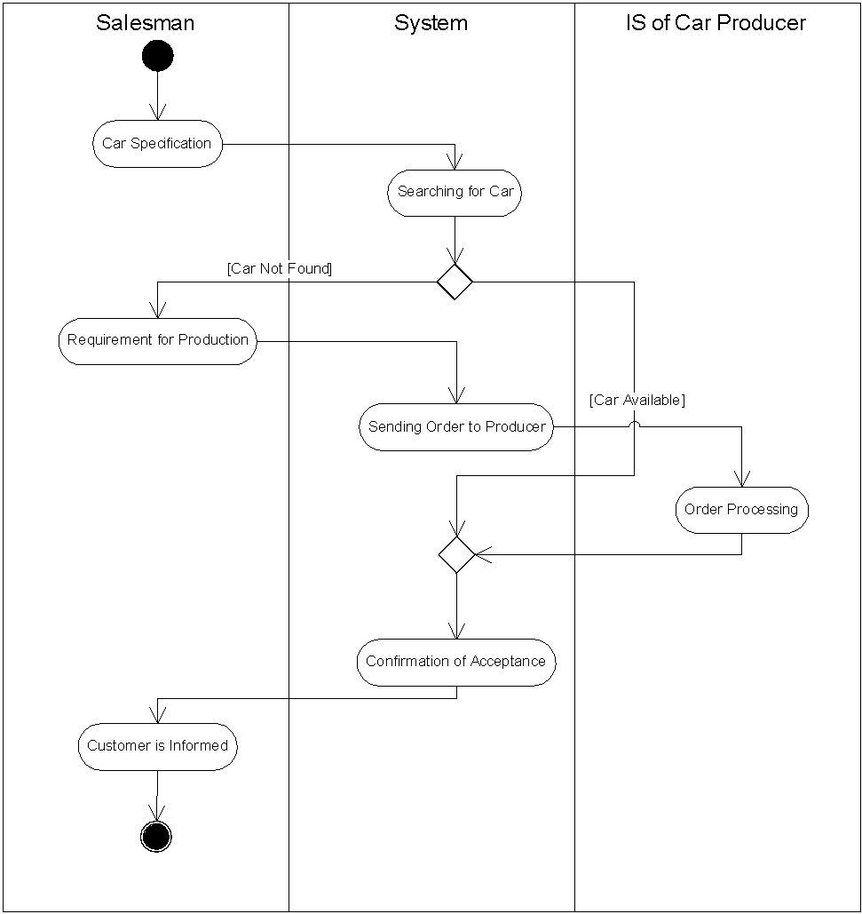
Use Case Scenario – Activity Diagram
Notes:
Use Case Scenario – Activity Diagram
The description of the flow of the communication between the customer and the system is called scenario.
Activity diagrams are another useful tool that can be used for the description of the scenario. It is common that more complex scenarios are described by the activity diagrams.
If there are activity diagrams used for the description of the scenarios then it is useful to use partitions in the diagrams. Partitions show the responsibility of each role to these activities.

Slide 157
Use Case Model - Basic Elements
The basic elements are
Actor – somebody or something that interacts with the system
Actor
Notes:
The basic elements of the use case model
The basic elements are:
Actor - somebody or something that interacts with the system, is outside the system
Actor is a simple figure symbol in the diagram. The name of the actor is under the symbol.

Slide 158
Use Case Model - Basic Elements
The basic elements are
Use case – represents the added value, that the system has for the particular actor
Use case
Actor
Notes:
Use case – represents the added value, that the system has for the particular actor
Use case describes the sequence of the activities that are performed by the actor and the system. Activities that are performed to reach the desired business goal that is supported by the system.
Use case describes:
System, its environment and the relations between them.
Surrounding systems or people that interact with the system.
Planned behavior of the system.
Use cases are something like containers that contain related requirements. They concentrate all requirements that are necessary to reach the desired business goal to one scenario that describes how to reach this goal.
Use case is modeled as an ellipse in the use case diagram. Name of the use case is in the middle of the ellipse or alternatively under the ellipse.

Slide 159
What Exactly Is Use Case? I
Use Case
defines the sequence of the actions performed by the system the that has a visible result for the particular actor.
Use Case
Notes:
What Exactly Is Use Case?
Use case describes possible communication with the system. It describes the complete walkthrough thorough the system that is necessary to reach the goal that demands the actor that is assigned to that use case.
Use case then:
Defines the sequence of the actions – that are atomic activities, decisions and requirements. Each action is performed completely or not performed at all.
Actions performed by the system – actions that are performed by the system are functional requirements.
Actions that have visible results – it is important to remember that the use case has to have a visible result. Why should anybody use the system if there is no required result? If the use case is not helpful to anybody then it’s probably too small. It is necessary to combine it with other use case to reach the desired goal for the particular actor.

Slide 160
What Exactly Is Use Case? II
Use Case
defines the sequence of the actions performed by the system that has a visible result for the particular actor.
Use case
Actor
Notes:
For the particular actor – decision, which actor demands the result of the particular use case helps to eliminate too general use cases or too small use cases. If there are more actors that can reach different business goals by one use case then this use case is too general and tries to reach too many goals for different actors. If the goal is too small and it has no business value, than the use case is too small and should it be combined with other use cases to reach the business goal.
There are situations where there are more actors cooperating on one use case. Since only one actor reaches the desired business goal, this connection is allowed. The actor that reaches its goal is called primary actor. Primary actor is usually actor who initialized the use case. Other cooperating actors are called secondary actors.

Slide 161
Benefits of Use Cases I
They represent the meaning of particular use cases
Describe requirements of the system in a logical order
Describe why the system is important
Help to identify all requirement of the system
Notes:
Benefits of the Use Cases
Use cases are a tool to organize requirements from the perspective of the user. All requirements that help (to) reach one particular goal for the user are collected to the use case that reaches the business goal. Use case model is then the collection of all particular use cases.
Benefits are:
They represent the meaning of particular use cases
Use cases show why the system is necessary and what goals can be reached by the using the system.
Use case then describes the requirements in a logical order, describes, why the system is important and helps to identify all requirements of the system.

Slide 162
Benefits of Use Cases II
They are easy to understand
Use a terminology that is understandable to the customers and users
Describe the usage of the system
Verify the understanding of the customer needs
Help to make a deal with the customer
Notes:
Benefits of the Use Cases II
Use cases are easy to understand
Use case model describes the requirements from the perspective of the user by normal language. Use case model shows what the user thinks that the system should do.
Helps to make a deal with the customer
Use case model is a mediator between the customer and the system developers.

Slide 163
Use Case Lifecycle I
Discovery
Registration close
Brief Description
Brief Description: this use case enables the department of students affairs to close the registration process. Subjects that have not enough students are canceled.
Notes:
Use case lifecycle
In most cases, it is not possible to describe use case completely. Similarly as any other iterative process, the description of the use case is continuous development activity that starts with the discovery of the use case and ends with its complete description.
The first step is a discovery of the use case. That is made by the identification of the use case name, goal and the name of primary actor of the use case. Use case is discovered if it is somehow named.
Immediately after the discovery of the use case there is another step. That step is a brief description of the use case. Brief description describes the goal of the use case, the description is made by several sentences. For example: we have identified the use case Registration close. Its brief description is: this use case enables the department of students affairs to close the registration process. Subjects that have not enough students are canceled.

Slide 164
Use Case Lifecycle II
Registration close
Content
Complete Description
Registration close – Complete description
- Scenarios
Specific requirements
pre and post conditions
Notes:
Use case lifecycle
Next step is a description of the use case content. Content means a simple list that describes the basic workflow of the use case and the identification of the alternative flows. Description of the content helps us to identify scenarios and helps us to understand how extensive the use case will be and how much effort will be necessary to implement it.
The last step is a detailed and complete description od the use case. Complete description is made iteratively, when there is a need to implement that particular scenario.

Slide 165
Use Case Diagram
ATM (Automated Teller Machine)
Money withdrawal
Send a money
Customer
Bank
Money disposal
Checking the disposals
Accountant
Maintenance
Service
Notes:
Use Case diagram
Use case model describes what the system should do, its environment and relations between the actors and use cases.
The use case diagram is a graphical representation of the use case model.
For example the use case diagram of the ATM machine.
When you see that diagram you can easily describe the basic function of the ATM machine system and its priorities.
The priority is the withdrawal of the money. The ATM machine needs that use case as a basic functionality. Other use cases, send money and money disposals disposal are complementary functions to the basic function money withdrawal, but they are necessary for the architecture of the system.
It is useful to distinguish between primary and secondary use cases. Primary use cases are those use cases that are directly connected to the business goals that the system should support. Secondary use cases are those use cases that are necessary because of the technical solution. For example – maintenance of the ATM, backup etc.
Use cases might be described in more diagrams than one for example to highlight the important use cases of each actor.

Slide 166
Business Modeling
The main goal of the business process modeling is to provide common language for communities of software and business engineers.
Business Process Modeling (How & When). Business process is a set of one or more linked procedures or activities which collectively realize a business objective or policy goal.
Domain Modeling (Who & What) captures the most important objects in the context of the system. The domain objects represent the entities that exist in environment in which the system works.
Notes:
Why to use business modeling? Business modeling can be used as a tool to understand the problem domain. If the domain is not known to the developer, the business modeling can be used. On the other hand business modeling helps to understand the goal of the software system itself and does not have to be used only for the understanding of the domain.

Slide 167
About Methods for Business Modeling
Method is a well-considered (sophisticated) system of doing or arranging something.
Business Process is a set of one or more linked procedures or activities which collectively realize a business objective or policy goal, normally within the context of an organizational structure defining functional roles and relationships.
Business Process Model is the representation of a business process in a form which supports automated manipulation, such as modeling or enactment. The process definition consists of a network of activities and their relationships, criteria to indicate the start and termination of the process, and information about the individual activities, such as participants, associated data, etc.
Workflow is the automation of a business process, in whole or part, during which documents, information or tasks are passed from one participant to another for action, according to a set of procedural rules.
Notes:
Methods for business modeling represent a systematic way of specifying specify and analyzing business processes.

Slide 168
Purpose of Business Modeling
Business Process Re-engineering (BPR) - methods that support activities by which an enterprise reexamines its goals and how it achieves them, followed by a disciplined approach of business process redesign.
Enterprise Resource Planning (ERP) - an information system that integrates all manufacturing and related applications for an entire enterprise. Business modeling is the first step in the software process of the ERP implemenation.
Workflow Management (WFM) – generic software systems used for definition, management, enactment and control of business processes.

Slide 169
Ontology of Process Engineering
Business Process
(i.e. what is inteded to happen)
is defined in a
is managed by a
Process Specification
(a representation of what is intended to happen)
Workflow Management System
(controls automated aspects of the business process)
via
used to create and manage
composed of
Process Instances
(a representation of what is actually happening)
Subprocesses
include one or more
Activities
during execution are represented by
Activity Instances
define demand on
require
Roles
are mapped on
Resources

Slide 170
UML Diagrams for Business Modeling
Activity Diagram is a variation of a state machine in which the states represent the performance of activities and the transitions are triggered by their completion.
The purpose of this diagram is to focus on flows driven by internal processing.
Class Diagram is a graph of elements (in the scope of business modeling represented by workers and entities) connected by their various static relationships.
The purpose of this diagram is to capture static aspect of the business domain.

Slide 171
Motivating Example
Develop an information system for a car dealer. The application should collect and provide information about customers, their orders, cars, payments etc. The possibility to communicate with the car manufacturer to obtain updated offer of available cars or to order a car required by a customer should be the part of the system. The goal is to make the customer happy!

Slide 172
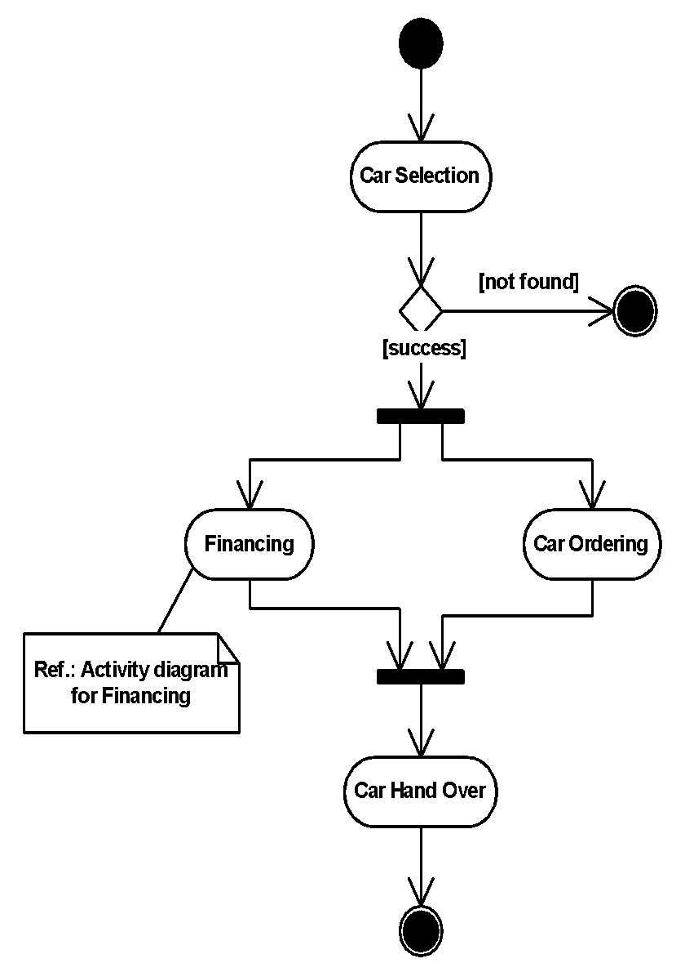
Activity Diagram: Car Sale Process
Initial
State
Control
Flow
Decision
Fork Transition
Note
Action State
(Activity)
Join Transition
Final
State
Notes:
Activity Diagram: Car Sale Process
Let us explain the business modeling captured by the activity diagram on this picture. The process starts with the activity Car selection. Then there is a decision whether the car was found or not. When the car was not found, the process ends.
When the car was found, the parallel part begins, two activities can be performed concurrently – Financing and Car ordering. When both these activities are completed the synchronization part lets the control flow continue to the activity Car hand over. This is the simple description of the Car sale process in the UML activity diagram.

Slide 173
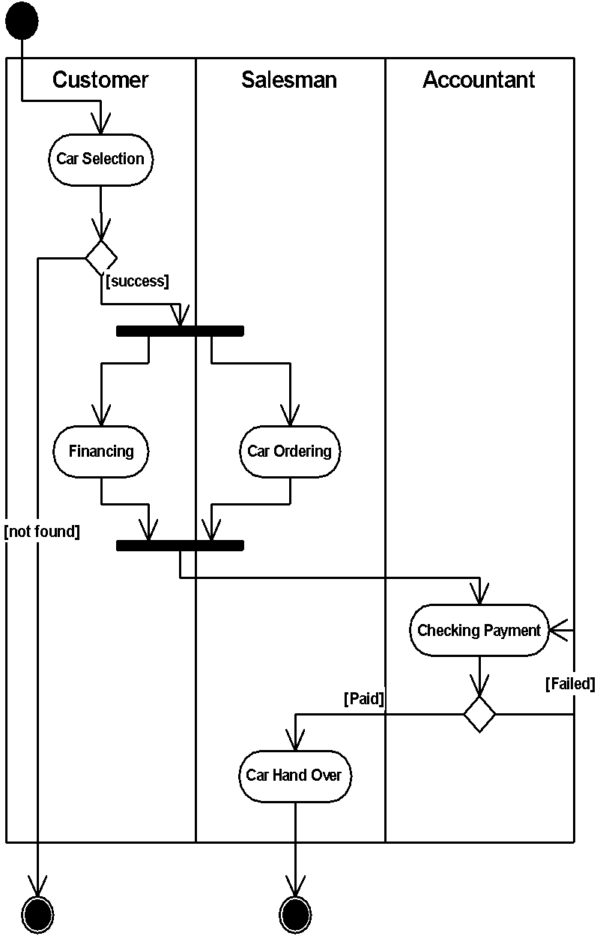
Swimlanes: Packages of Responsibilities
Notes:
Swimlanes: Packages of Responsibilities
Actions may be organized into swim lanes. Swim lanes are a kind of package for organizing responsibility for activities provided by workers.
This diagram shows the previous process divided into the swim lanes. There are three swim lanes are Customer, Salesman, Accountant. We can see that the Customer is responsible for the Car Selection, Financing, Salesman is responsible for the Car Ordering, Accountant is responsible for Checking Payment.

Slide 174
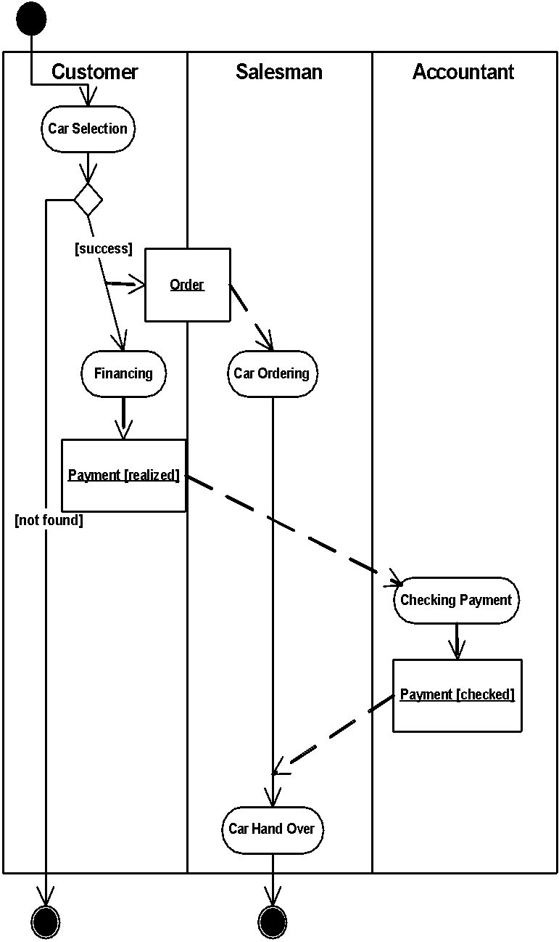
Activities and Entities
Object (Entity)
Flow
Entity
Notes:
Activities and Entities
Except of a activities and roles responsible for the particular activities, the diagram can show also the objects. Objects flow between the activities, objects are input and output data from and to activities. We can see, that the object Order, was created in the activity Car Selection. This object is then input to the activity Car Ordering. Object Payment in the state realized is the output of the activity Financing. Payment is then input object to the activity Checking Payment. The output of the checking payment activity is a object Payment again, but in the state checked. This payment is then the input activity to the activity Car Hand Over.

Slide 175
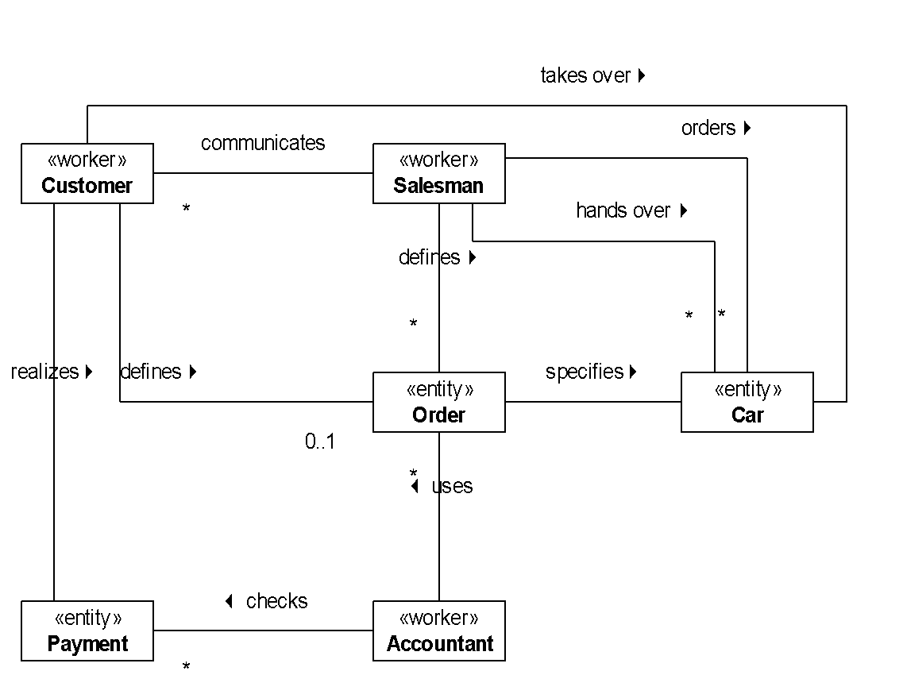
Class Diagram: Car Sale Elements
Worker defines the behavior and responsibilities of an individual
Entity is the process artifact
Multiplicity
Association
Notes:
Class Diagram: Car Sale Elements
The activity diagram is not the only diagram that can be used for the documentation of the business processes. The class diagram is used there for the description of the static part of the process. The static part means objects and their relations. We can see, that the process car sale need some workers – and entities. Workers are individuals, humans, that do some tasks or are responsible for some tasks. Entities are artifacts that are created or used during the process.
There are entities> Payment, Order, Car, and workers Salesman, Customer and accountant.

Slide 176
Requirements
The goal of the requirements workflow is to describe what the system should do by specifying its functionality. Requirements modeling allows the developers and the customer to agree on that description.
Use Case Model examines the system functionality from the perspective of actors and use cases.
Actors: an actor is someone (user) or some thing (other system) that must interact with the system being developed
Use Cases: an a use case is a pattern of behavior the system exhibits. Each use case is a sequence of related transactions performed by an actor and the system in a dialog.
Notes:
Requirements
Let’s repeat what are the requirements and how to capture the requirements by the use cases.
The goal of the requirements workflow is to describe what the system should do by specifying its functionality. Requirements modeling allows the developers and the customer to agree on that description.
Use Case Model examines the system functionality from the perspective of actors and use cases.
Actors: an actor is someone (user) or some thing (other system) that must interact with the system being developed
Use Cases: an a use case is a pattern of behavior the system exhibits. Each use case is a sequence of related transactions performed by an actor and the system in a dialog.

Slide 177
UML Diagrams for Requirements Modeling
Use Case Diagram shows the relationships among actors and use cases within a system.
The purpose of this diagram is to define what exists outside the system (actors) and what should be performed by the system (use cases).
Activity Diagram displays transactions being executed by actor and system in their mutual interaction.
The purpose of this diagram is to elaborate functionality of the system specified in a use case diagram.
Notes:
UML Diagrams for Requirements Modeling
As we have already thoroughly discussed, sometime we need to show and visually model the requirements. We can use two types of the UML diagram for this purpose.
Use Case Diagram shows the relationships among actors and use cases within a system.
The purpose of this diagram is to define what exists outside the system (actors) and what should be performed by the system (use cases).
Activity Diagram displays transactions being executed by actor and system in their mutual interaction.
The purpose of this diagram is to elaborate functionality of the system specified in a use case diagram.

Slide 178
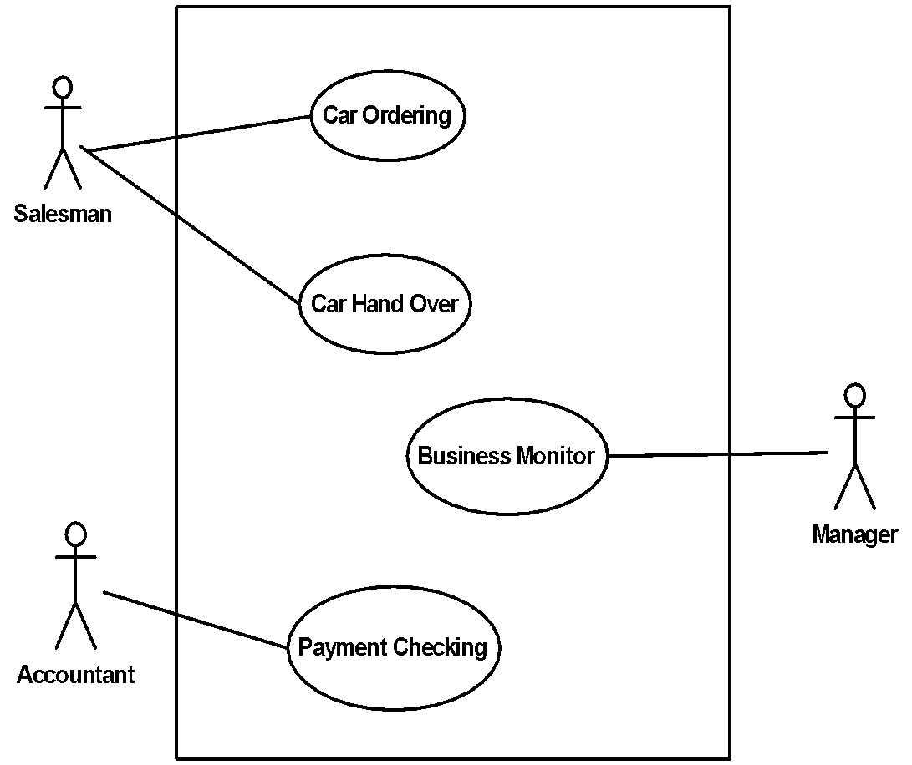
Use Case Diagram: Car Sale
Use Case
Actor
System Boundary
Notes:
Use Case Diagram: Car Sale
We can now start to model the use case model for the car sale system. We use a use cases as functional requirements, and use a use case diagram as a tool to express and visually show the relations between the use cases and actors. And the boundary and scope of the system.
We can see that we have three actors – user of the system to be built – Salesman, Accountant and Manager.
Salesman starts and has a connection to the use cases Car Ordering, and Car Hand Over.
Manager has a connection to the Business Monitor. Accountant has a connection to the Payment Checking.

Slide 179
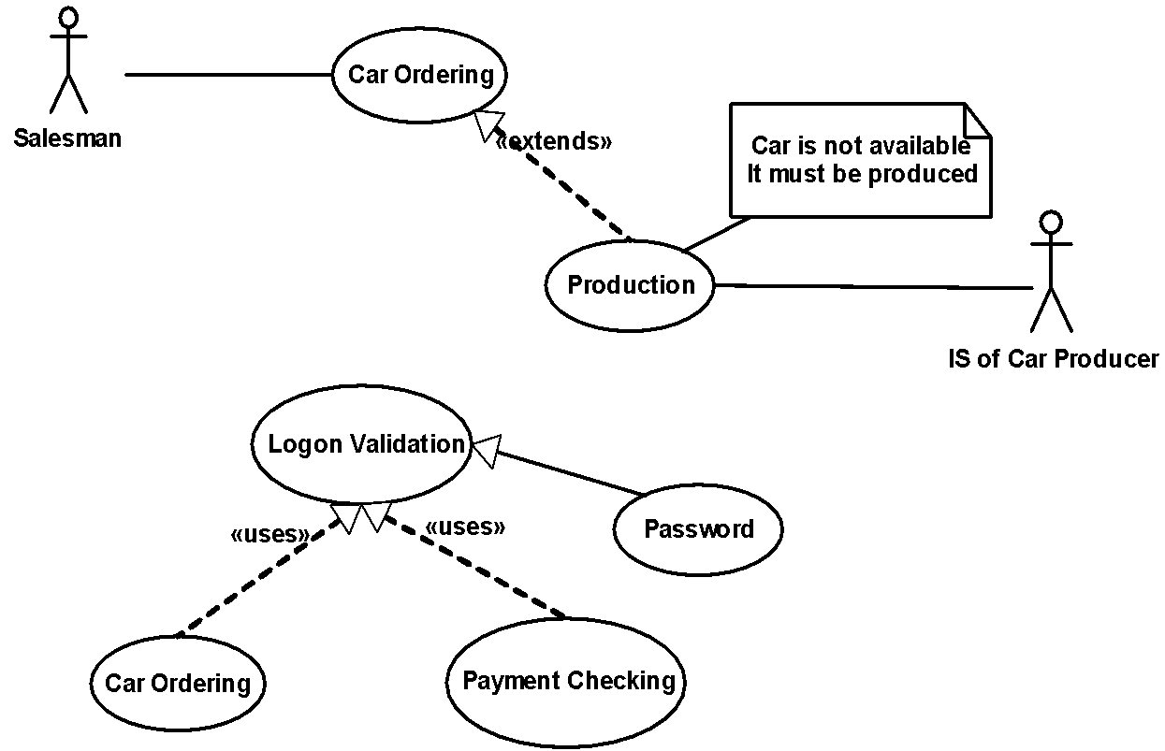
Structuring Use Cases
Notes:
Structuring Use Cases
Since there are many use cases and the support use cases might be used by more than one use case it is possible to use relations.
The relations are:
A generalization is the relationship between a more general use case (the parent) and a more specific use case (the child) that is fully consistent with first use case.
An extends relationship shows optional behavior
A uses relationship shows behavior that is common to one or more use cases
For example we can see, that the Car ordering is extended sometimes by the Car Production. Car Ordering uses Logon Validation, Payment Checking use a Logon Validation.

Slide 180
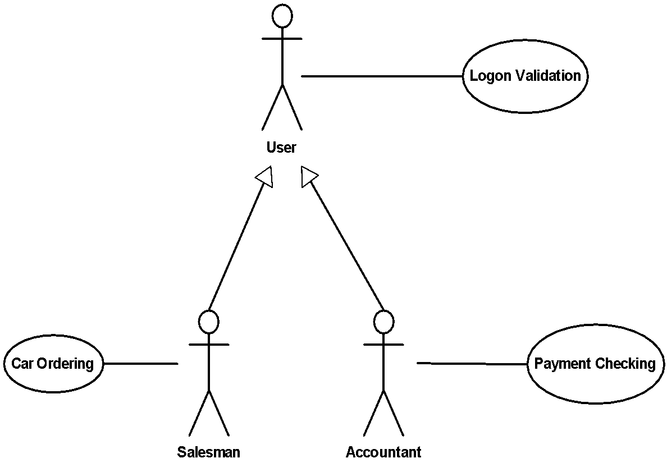
Structuring Actors
Notes:
Structuring Actors There might be many actors as well and they can use the same use cases. If this situation occurs the diagram would looks like a mess. There would be a lot of lines connecting particular actors with their use cases. For example, Salesman have a use case car ordering, Accountant have a use case Payment Checking. Both these actors has a use case logon validation. In case that we would like to show that in one diagram the diagram might start to be unreadable. Hence, we can use a structuring between actors.
A generalization is the relationship between a more general actor (the parent) and a more specific actor (the child) that is fully consistent with first actor.
We can even add a new (sometimes abstract like here) actor - user, that is connected to the use case Logon Validation. Actors Salesman and Accountant are specialization (or we can say – they inherit from the actor) of the actor User.

Slide 181

Elaborate Functionality of Car Ordering
Actor’s responsibility
Actor’s responsibility
System transactions
Notes:
Elaborate Functionality of Car Ordering
On this picture, we can see what the final requested functionality of the system is. The salesman performs Car Specification, system then searches for the car. If the car is not found, the system informs salesman that the production must be done. Salesman confirms that and the system should send the order to the producer, Car producer has to process the order and confirm it. If the car is available, when the system searches for it, the flow continues to the confirmation directly. Then the system informs a salesman about the order and the salesman has to inform the customer. The process ends. That is the final derived functionality of one requirement.

Slide 182
ANALYSIS AND DESIGN

Slide 183
Analysis & Design
The goal of the analysis & design workflow is to show how the system will be realized in the implementation phase.
Analysis Model examines requirements from the perspective of objects found in the vocabulary of the problem domain.
Design Model will further refine the analysis model in light of the actual implementation environment. The design model serves as an abstraction of the source code; that is, the design model acts as a 'blueprint' of how the source code is structured and written.
Deployment Model establishes the hardware topology on which the system is executed.

Slide 184
UML Diagrams for Analysis & Design
Class Diagram shows set of classes, interfaces and their relationships
Class diagrams address the static design view of the system.
Sequence Diagram is an interaction diagram that emphasizes the time ordering of messages.
Collaboration Diagram displays object interactions organized around objects and their links to one another
An interaction diagram that emphasizes the structural organization of objects that send and receive messages.
Statechart Diagram shows the life history of a given class and the events that cause a transition from one state to another
Deployment Diagram shows the configuration of run-time processing elements
The purpose of this diagram is to model the topology of hardware which the system executes.

Slide 185
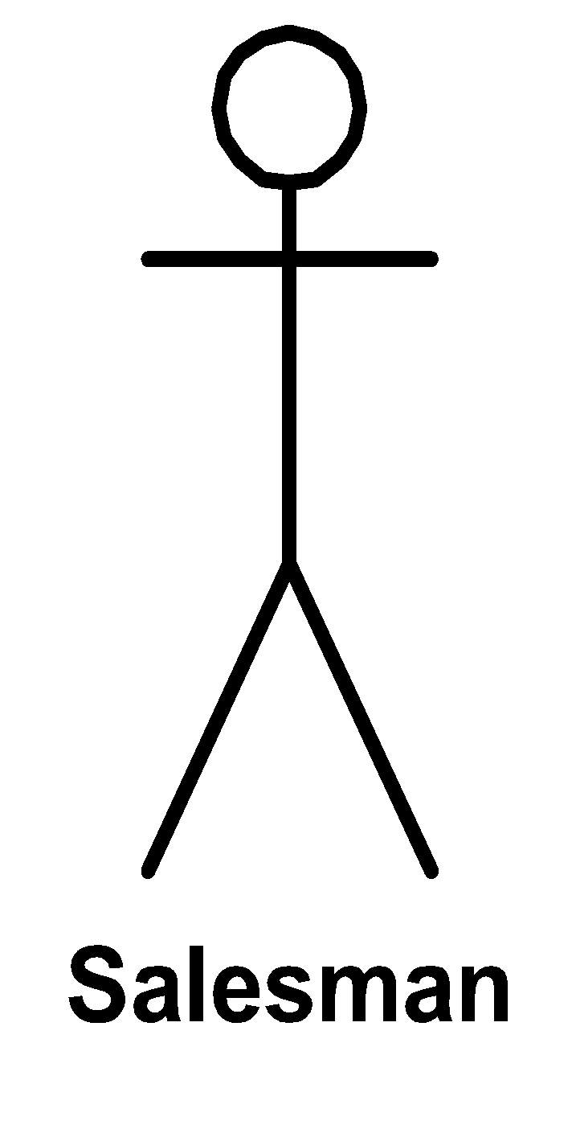
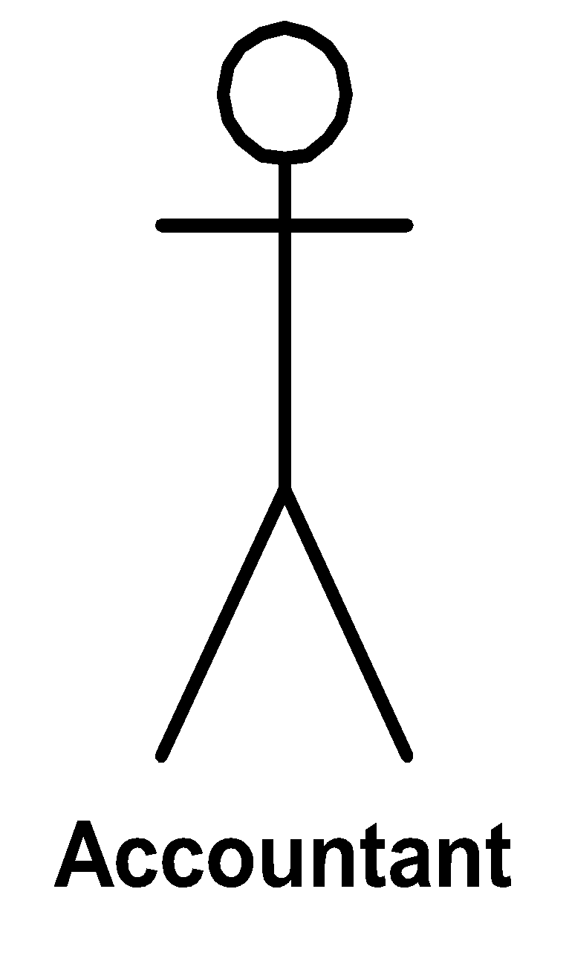
Use Cases and Objects
Objects are enablers of the sequence of transactions required by the use case. Use cases and objects are different views of the same system. An object can therefore typically participate in several use cases.
Objects
Warehouse
Manager
Order
Use Cases

Slide 186
What is an Object?
An Object is an identifiable individual entity with:
Identity: a uniqueness which distinguishes it from all other objects
Behavior: services it provides in interactions with other objects
Secondary properties:
Attributes: some of which may change with time
Lifetime: from creation of the object to its destruction
States: reflecting different phases in the object’s lifecycle

Slide 187
Views of Object
External
Responsibilities of that object
Services provided
Visible properties and associations
Externally visible protocols and interactions
Internal
Data representations
Implementations of behaviors

Slide 188
Relationships Among Objects
Links A link is a physical or conceptual connection between objects (John Smith works-for Simplex company). Mathematically, a link is defined as a tuple, that is, an ordered list of objects.

Slide 189
Objects and Their Interactions
A set of interconnected objects constitutes the system
Interactions between objects result in:
Collective behaviors being exercised
Changes in the logical configurations and states of the objects and system

Slide 190
System Architecture
The organizational structure and associated behavior of a system.
DB - Persistence
Core = Model
User Interface
Adapter
object
Adapter
object
Distribution
Notes:
System architecture
System architecture is the key to the successful implementation of the software system. System architecture must be so robust to enable it to satisfy all requirements. The other important requirement for the robustness of the architecture is the need to be able to accept all changes of the requirements. These two architecture requests and the customer requirements that have to be satisfied form the system architecture. The basic view of the architecture is a division of the system into the four parts: Core model, distribution layer, data layer and user interface layer.

Slide 191
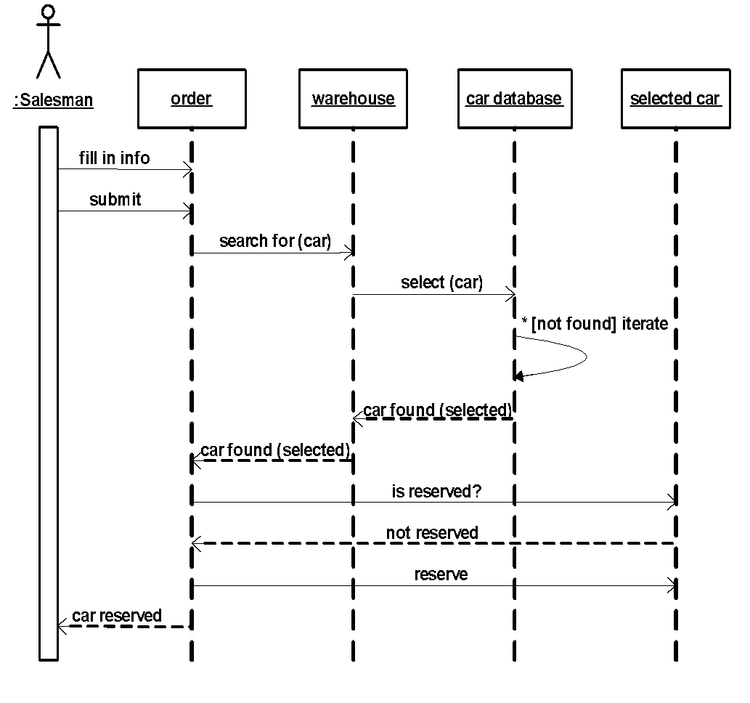
Sequence Diagram: Car Ordering
Object
Time
Activation (focus of control) shows the period during which an activity is performed
While loop; the message is repeated until the condition is fulfilled
Asynchronous message; the sender dispatches the Stimulus and immediately continues with the next step in the execution.
Synchronous message (procedure call); the sender waits for the response (return message).
Return message; response to the sender
Notes:
Sequence Diagram: Car Ordering
Sequence diagram is a tool to describe a dynamic behavior of the system. It might be shown from the start when the actor initializes something or some behavior inside the system.
The diagram consists of dashed lines that are representing the life line of the objects and actors. Messages are sent between the objects.

Slide 192
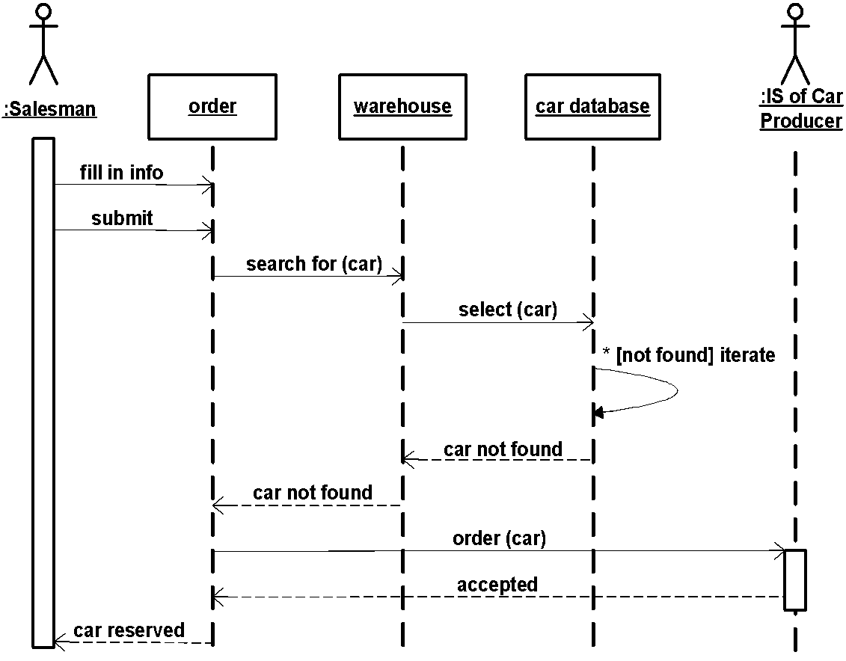
Alternative Scenario
External Information System
Object Lifeline
Notes:
Alternative Scenario
Sequence diagrams are showing the real state of the communication between the objects, not the general prescription as a class diagrams.
So, when the communication between the objects is different, a new diagram has to be drawn.

Slide 193
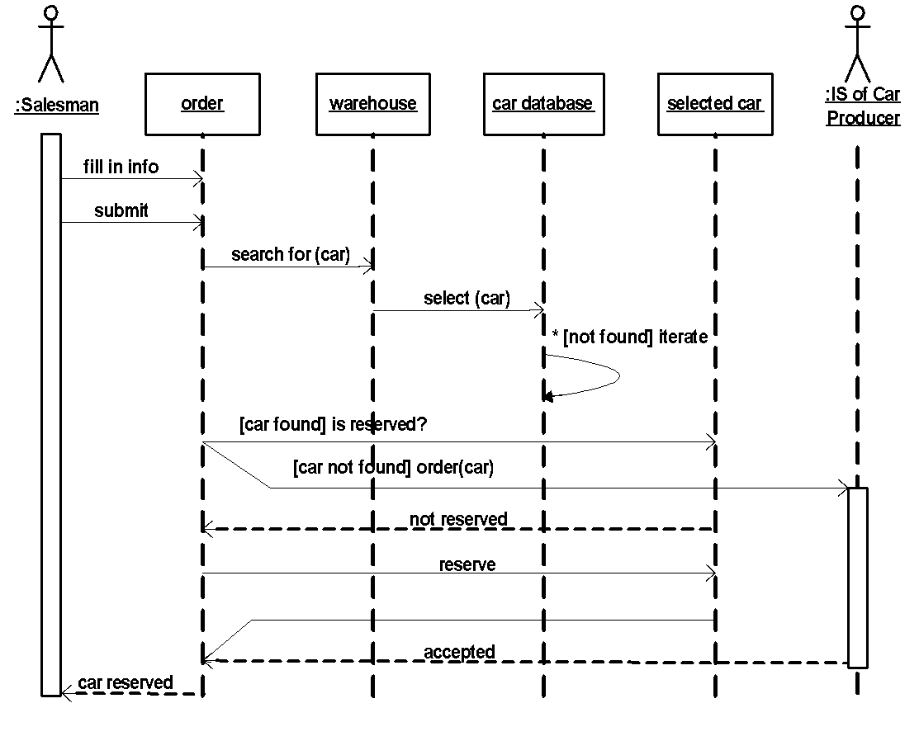
Merging Scenarios
Branching
Joining scenarios
Notes:
Merging Scenarios
Of course, when the problem of the different communications is only the part of the communication between the objects, then the diagrams that show the different scenarios can be merged together.

Slide 194
What is a Class?
A class is the descriptor for a set of objects with common structure, behavior, relationships and semantics.
Classes are found by examining the objects in sequence diagrams.
Every object is an instance of one class.
Classes should be named using the vocabulary of the domain.

Slide 195
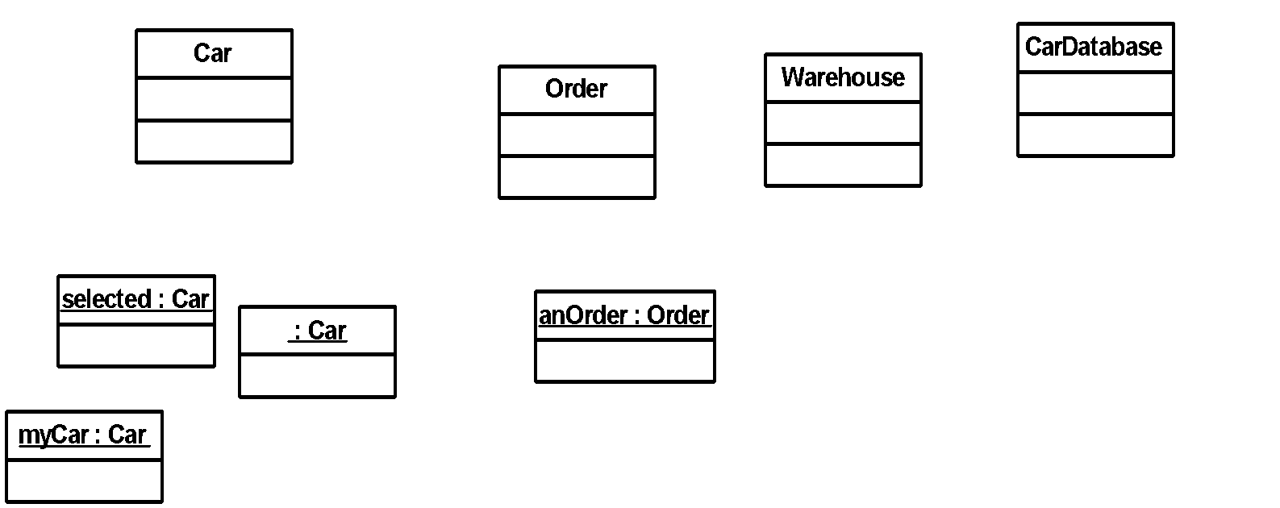
Objects and Classes
Notes:
Objects and Classes
Classes identified in the domain. All classes are singular nouns starting with uppercase letter.
Objects (instances) instantiated from classes. A name of an object is underlined. Colon separates the name and the class of the object. Names usually start with lowercase letter.

Slide 196
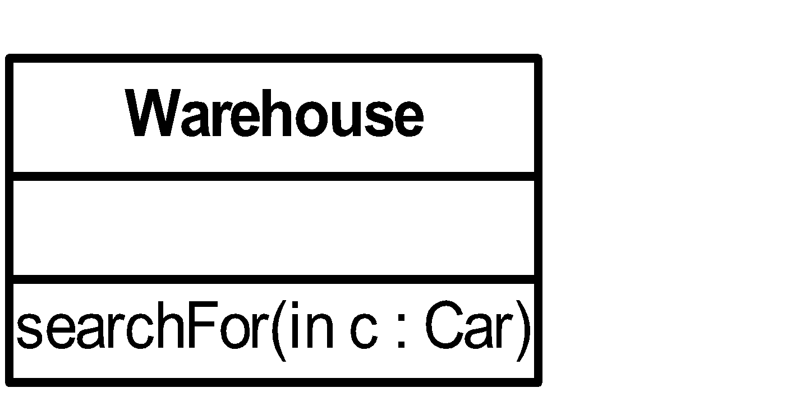
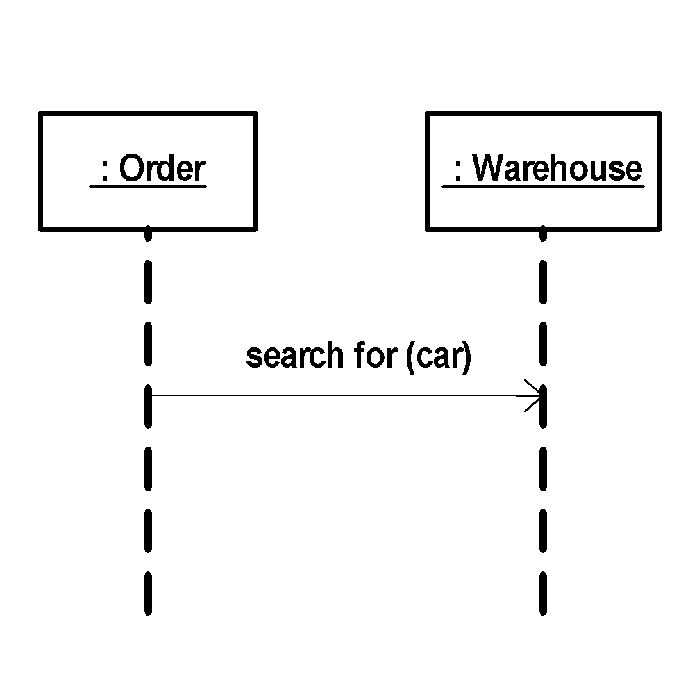
Operations
The behavior of a class is represented by its operations.
Operation may be found by examining interaction diagrams

Slide 197
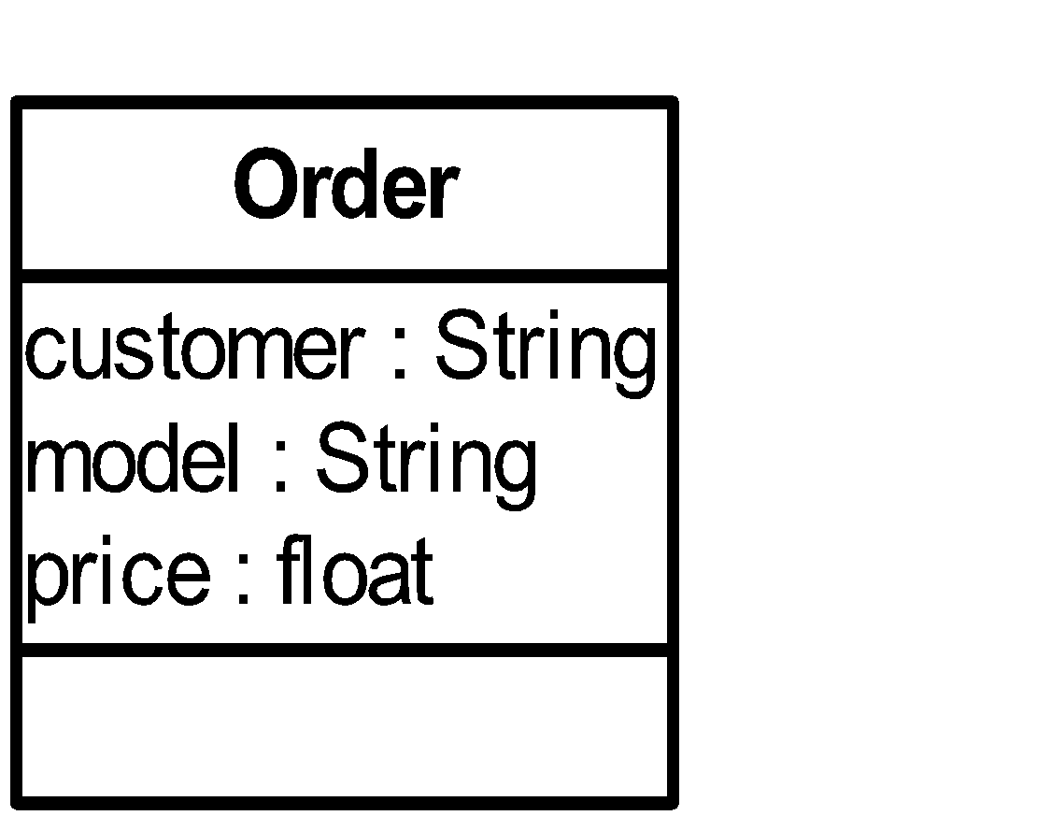
Attributes
The structure of a class is represented by its attributes.
Attributes may be found by examining class definitions, the problem requirements, and applying domain knowledge.
A customer has chosen a model of the car and has to pay for it some price.
Notes:
Attributes

Slide 198
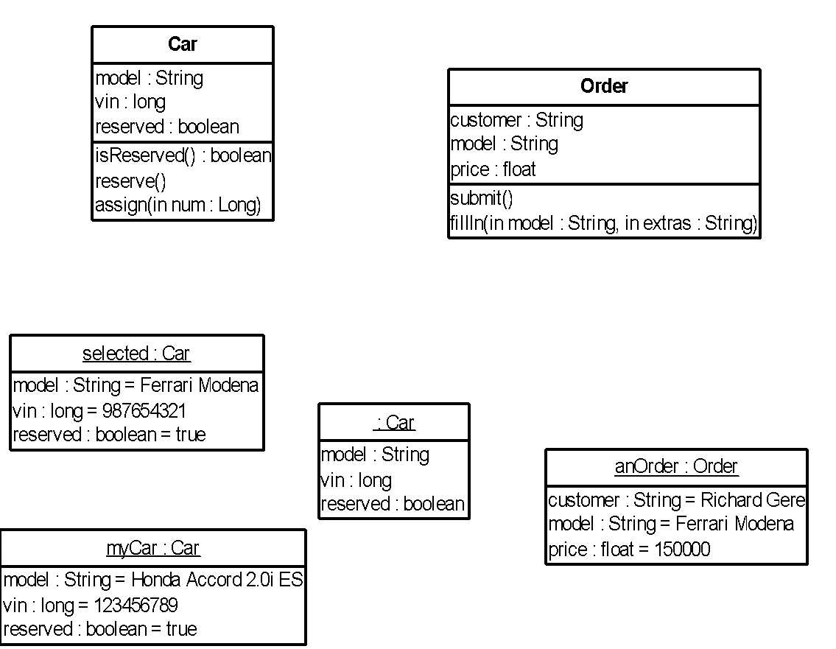
Operations and Attributes
Attributes and their types
Operations, their parameters and return values
Values held by the object

Slide 199
Relationships
Relationships between classes specify a way for communication between objects.
Sequence and/or collaboration diagrams are examined to determine what links between objects need to exist to accomplish required behavior. Objects can send messages to each other only if the link between them is established.
A sequence diagram emphasizes the time ordering of messages.
A collaboration diagram emphasizes the structural organization of objects that send and receive messages.

Slide 200
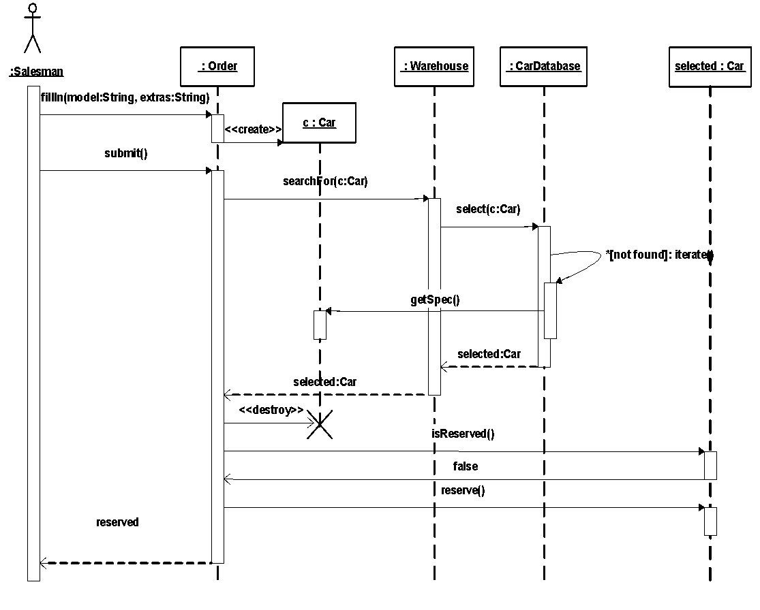
Refined Sequence Diagram
Object creation (stereotype create)
Synchronous message with arguments
Recursion
Object destruction
(asynchronous message)

Slide 201
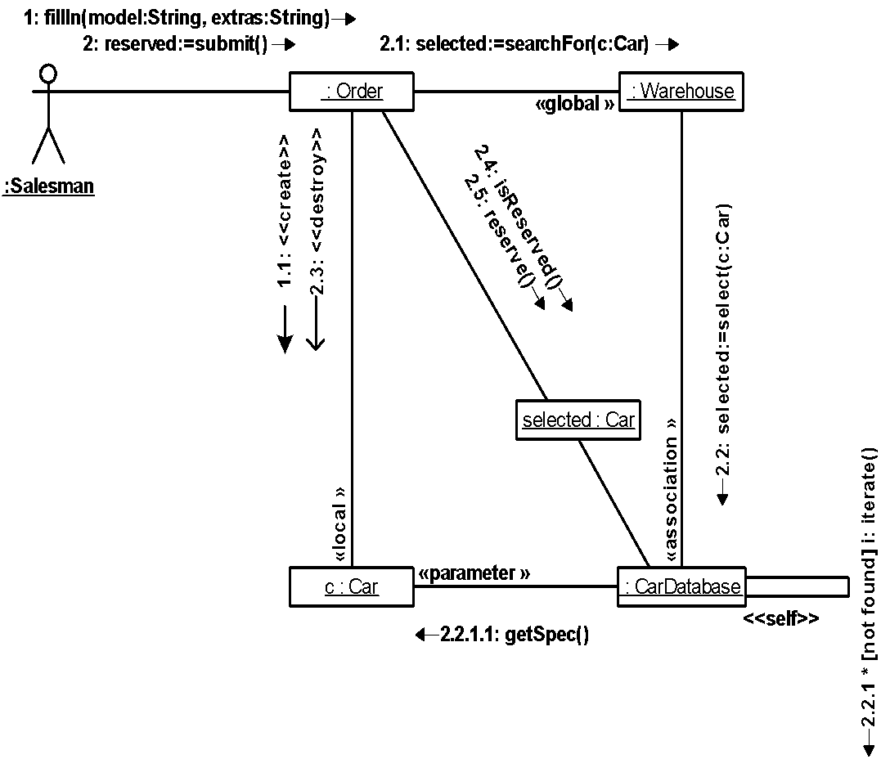
Collaboration Diagram
Synchronous message with arguments
Link between objects
Return value
Asynchronous message
Visibility
(local stereotype)
Message order

Slide 202
Types of Relationships
Association describes a group of links with common structure and common semantics (a Person works-for a Company). An association a bi-directional connection between classes that describes a set of potential links in the same way that a class describes a set of potential objects.
Aggregation is the “part-whole” or “a-part-of” relationship in which objects representing the components of something are associated with an object representing the entire assembly.
Dependency is a weaker form of relationship showing a relationship between a client and supplier.
Generalization is the taxonomic relationship between a more general element (the parent) and a more specific element (the child) that is fully consistent with the first element and that adds additional information.

Slide 203
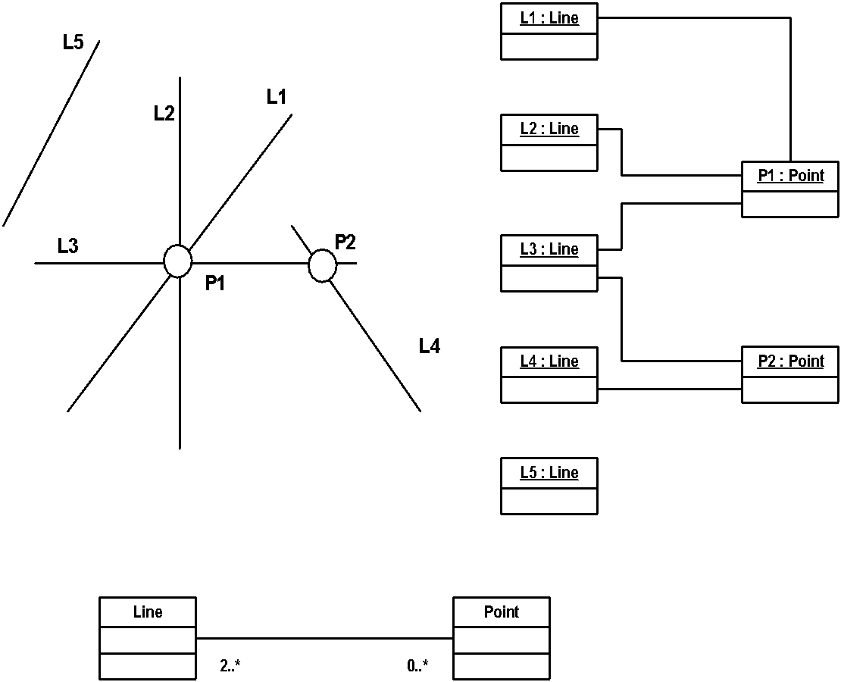
Links and Associations
Reality
Association
Links among objects
Multiplicity

Slide 204
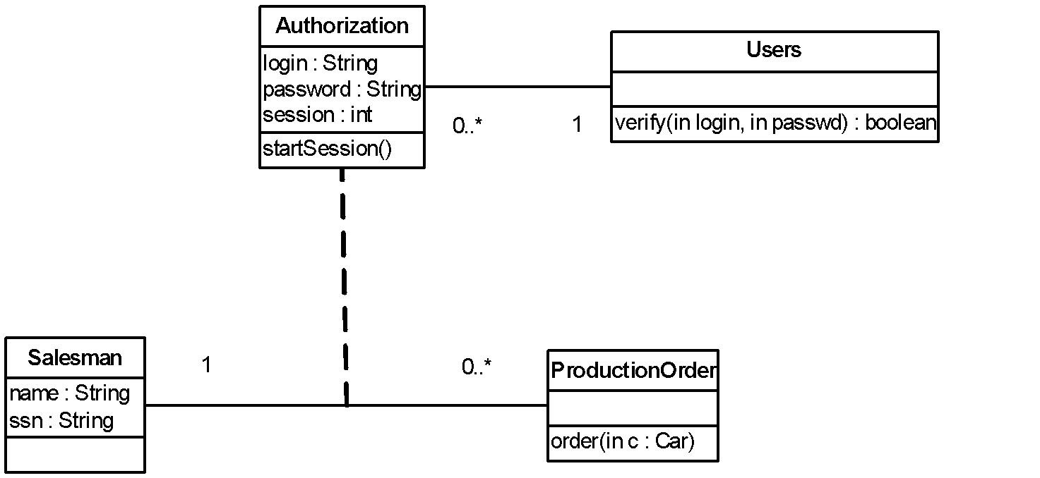
Association Classes
Association between classes
Notes:
Modeling an association as a class
Association Class is an association that also has class properties (or a class that has association properties).

Slide 205
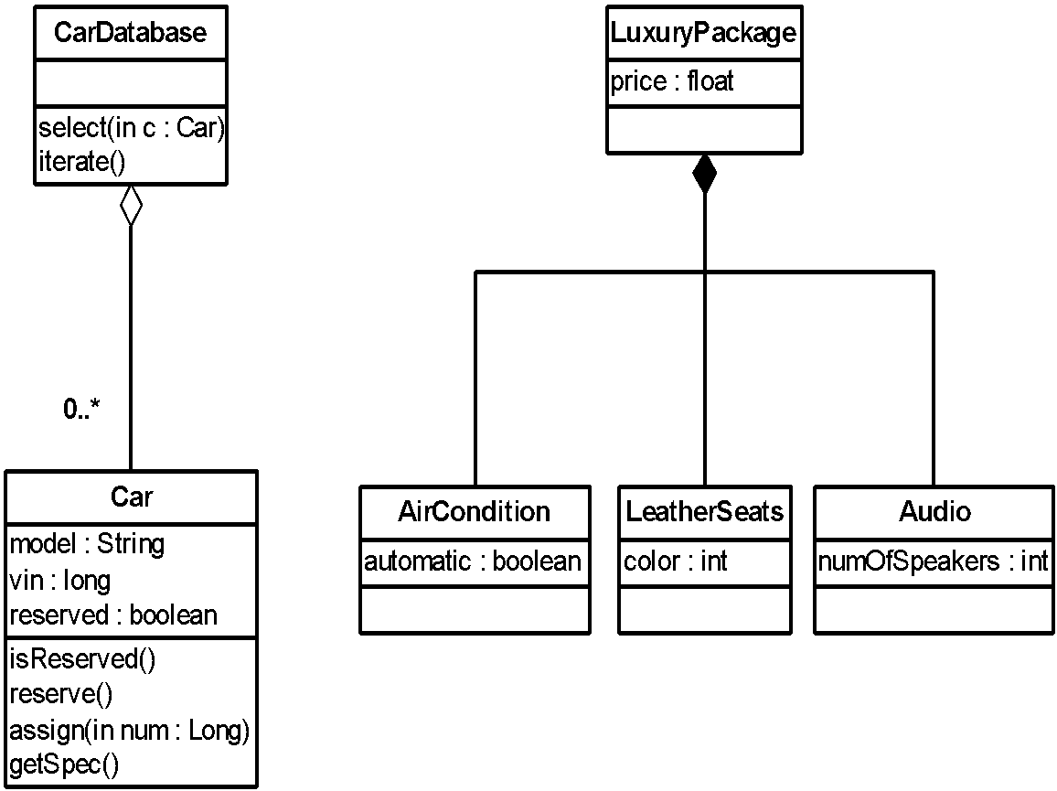
Aggregations
Aggregate
Composite
Composition; the part is strongly owned by the composite and may not be part of any other
composite.
Shared aggregation; the part may be contained in other aggregates.
Part

Slide 206
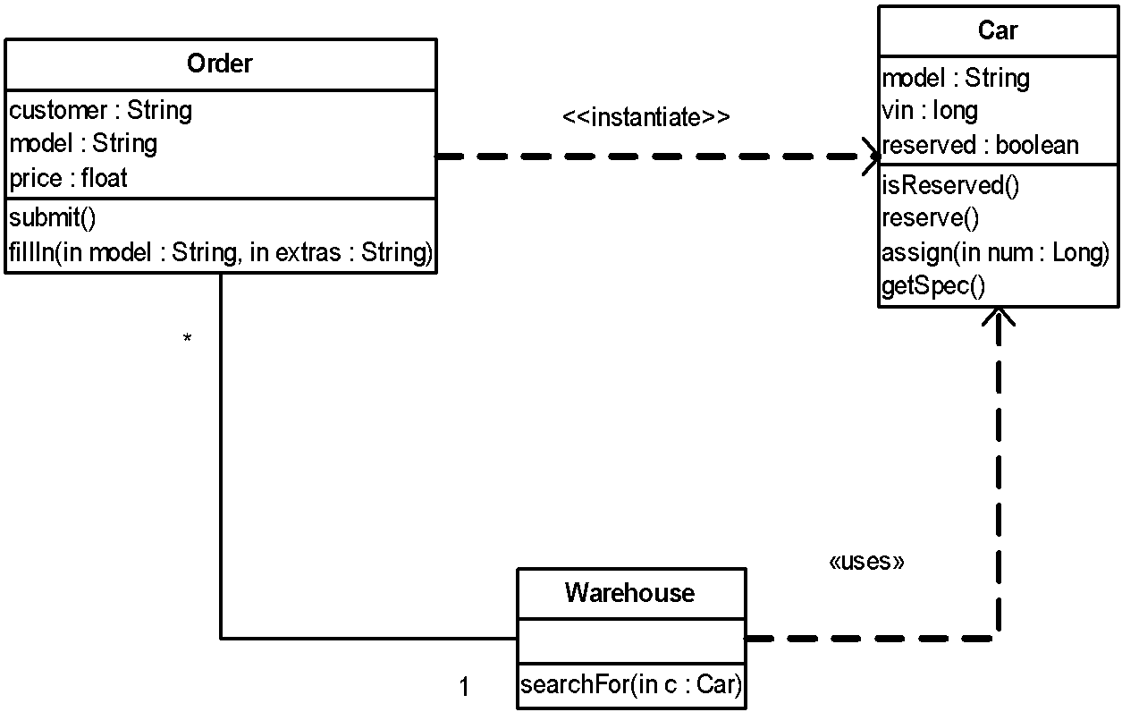
Dependency
The client class uses the supplier to create its instance.
Association with navigation
The most common kind of dependency relationship is the connection between a class that only uses another class as a parameter to an operation.

Slide 207
Roles, Types and Interfaces
Role is the named specific behavior of an object participating in a particular context (the face it presents to the world at a given moment).
Type specifies a domain of objects together with the operations applicable to the objects (without defining the physical implementation of those objects).
Interface is the named set of externally-visible operations.
Notions of role, type and interface are interchangeable.

Slide 208
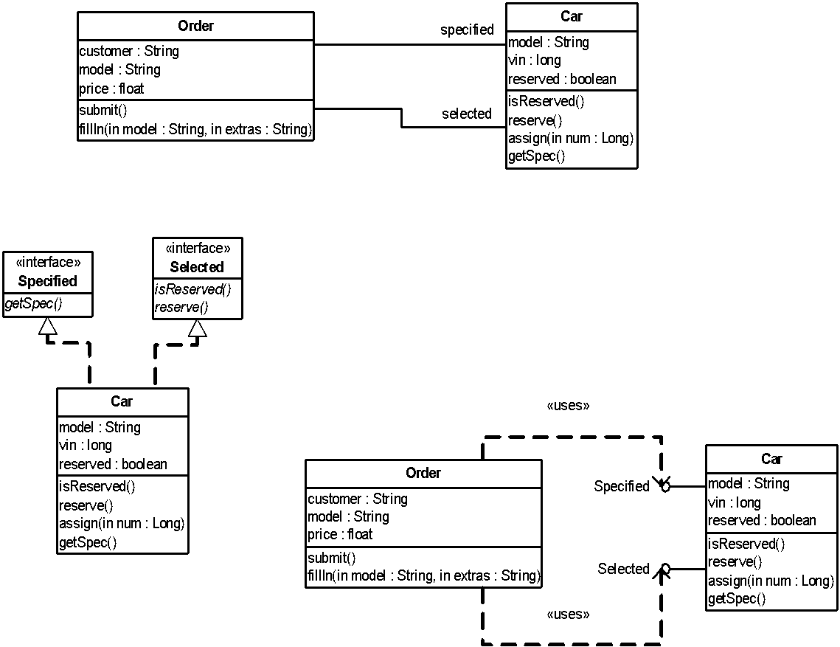
Type and Implementation Class
Realization
Type specified by the interface
Role
Implementation class defines the physical data structure (for attributes and associations) and methods of an object.
Interface

Slide 209
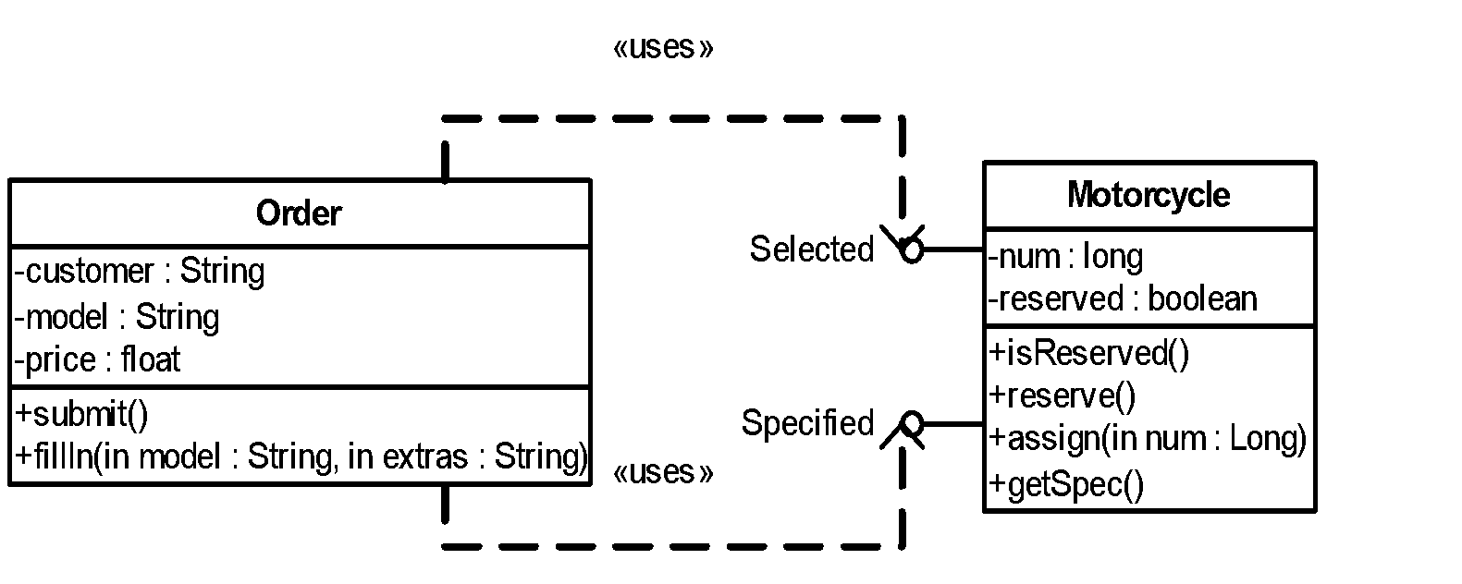
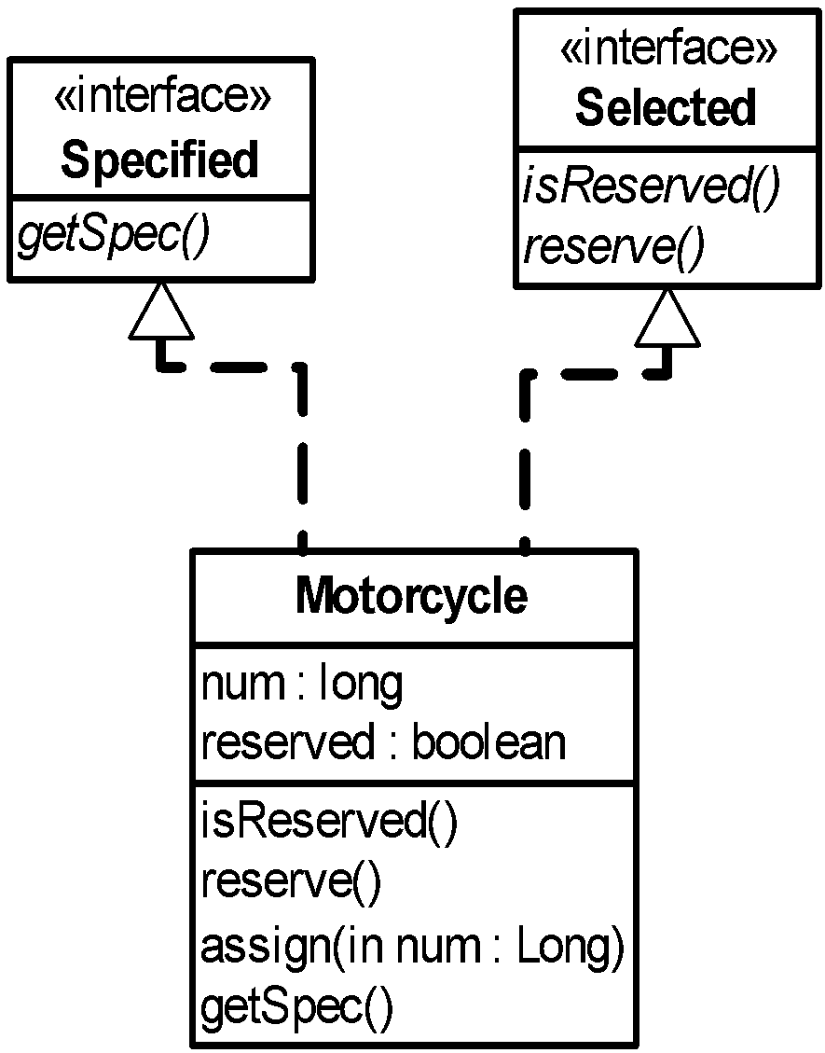
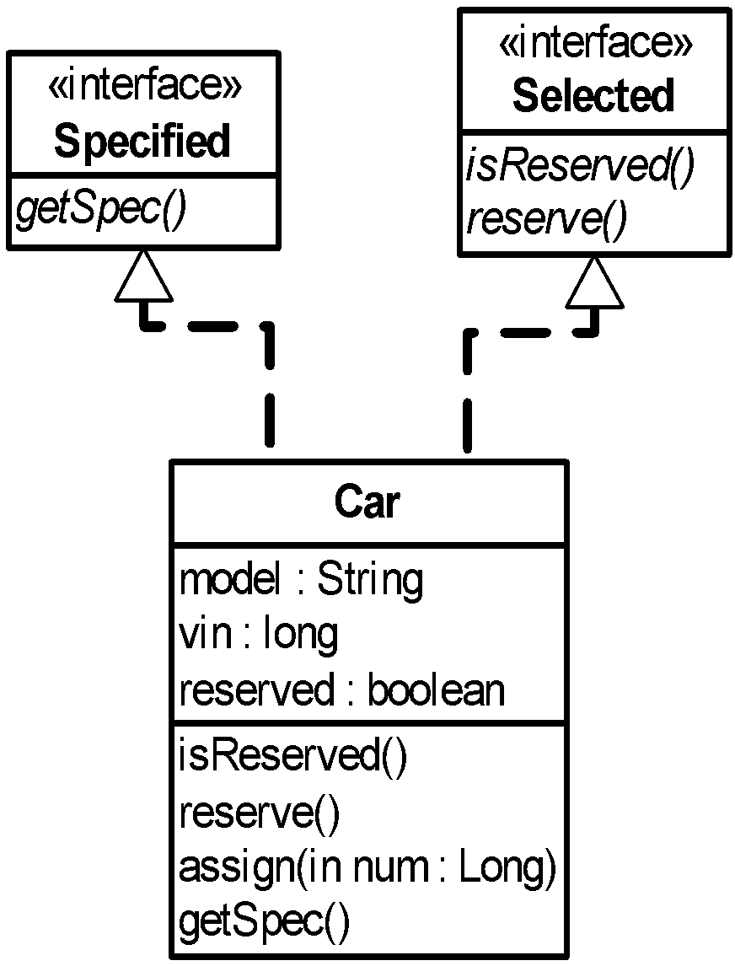
Implementation Independence
Interface for Order remains the same!

Slide 210
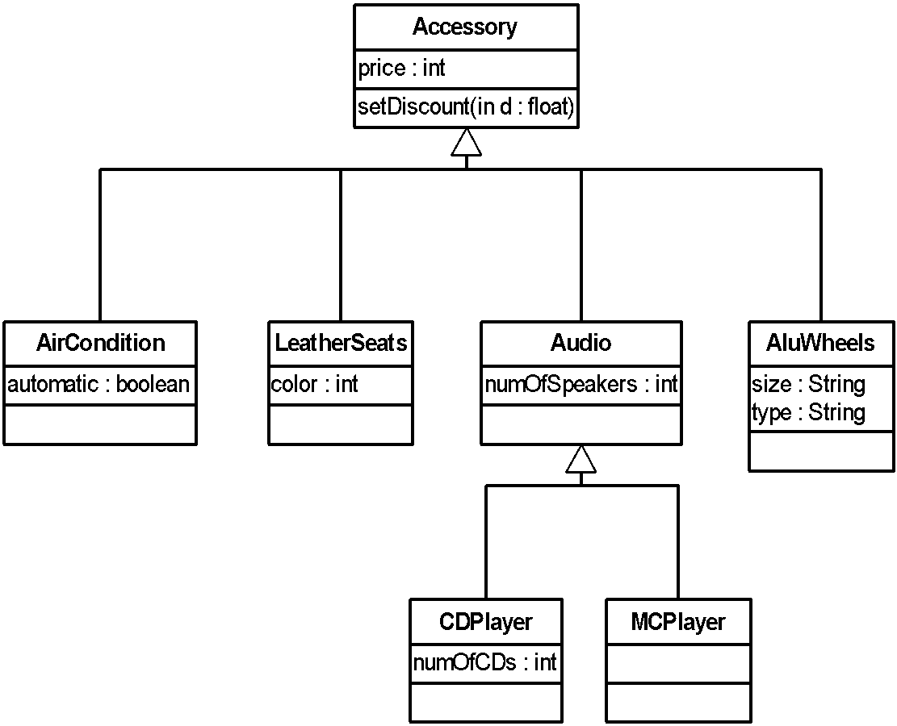
Generalization/Specialization
Subclass. Each subclass can define its own implementation of attributes and services.
Superclass
Generalization
Inheritance: re-use of implementation

Slide 211
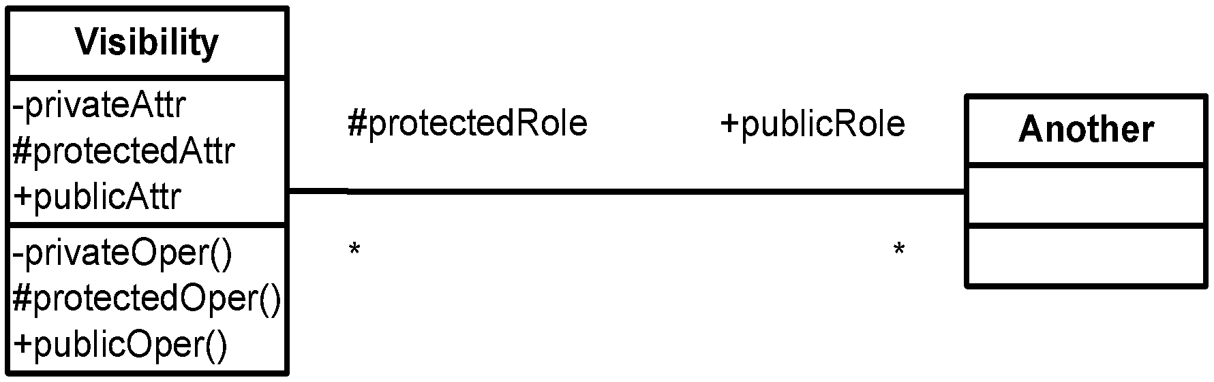
Visibility
Public declaration is accessible to all clients.
Protected declaration is accessible only to the class itself and its subclasses.
Private declaration is accessible only to the class itself.

Slide 212
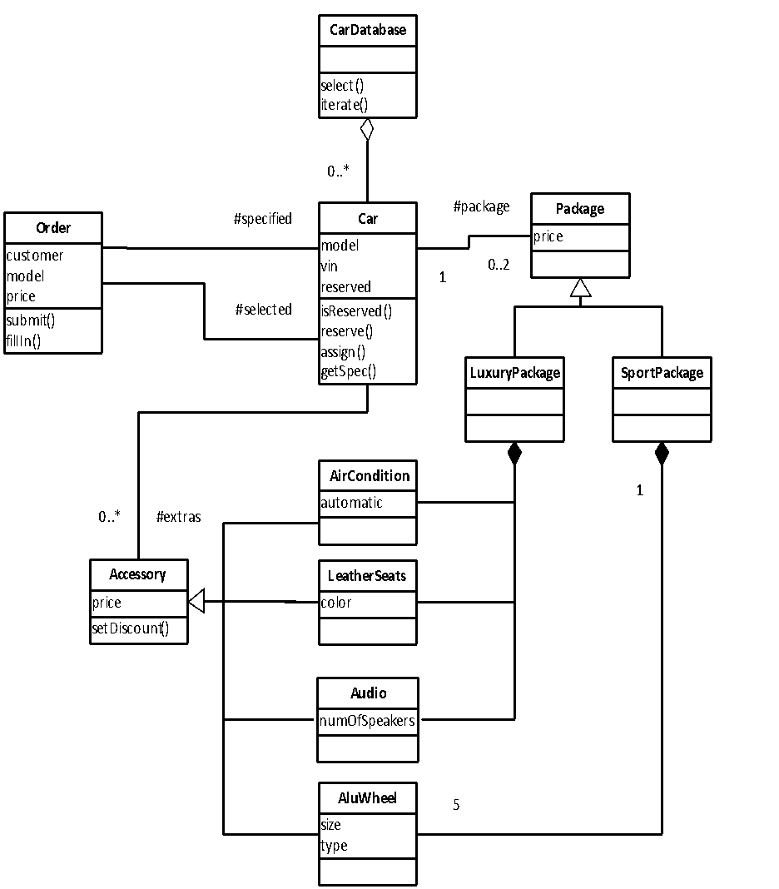
Class Diagram
Abstract Class: class that cannot be directly instantiated.
A class diagram is a graphic view of the static structural model.

Slide 213
The Dynamic Behavior of an Object
A state transition (statechart) diagram shows
The life cycle of a given object
The events causing a transition from one state to another
The actions that result from a state change
State transition diagrams are created for objects with significant dynamic behavior
Sequence and/or collaboration diagrams are examined to define statechart diagram of a class

Slide 214
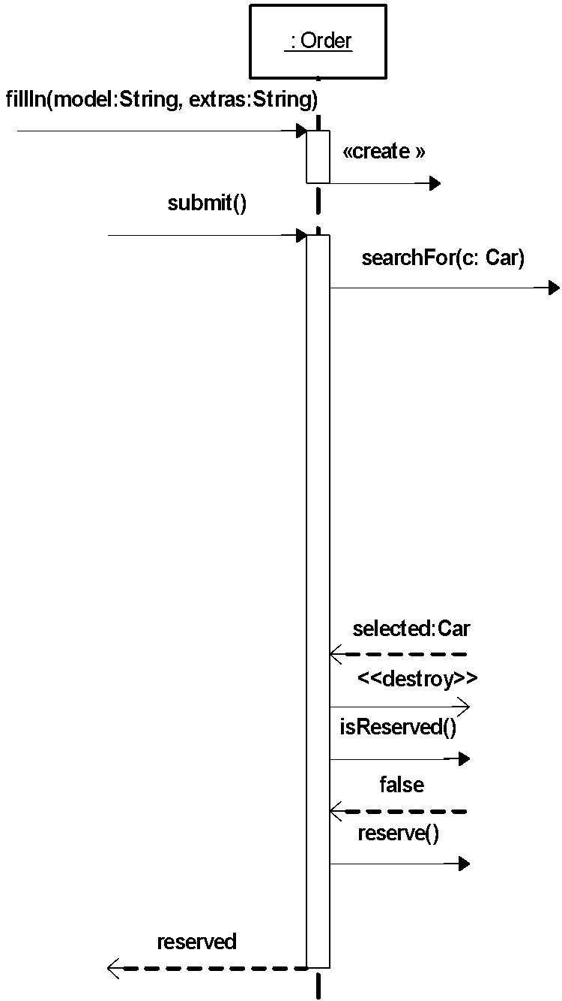
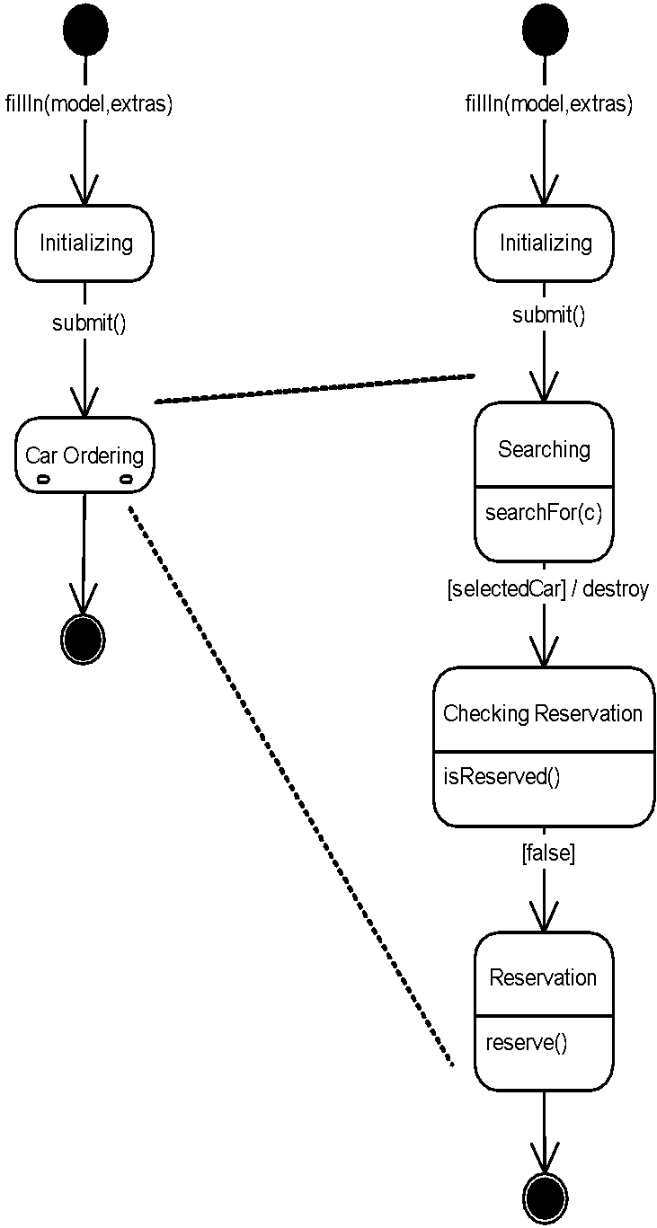
Statechart Diagram
External event
State
Composite
State
Action
Guard
A statechart diagram for a class Order

Slide 215
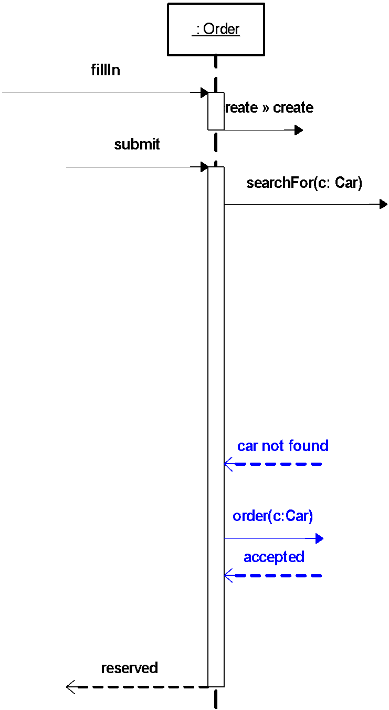
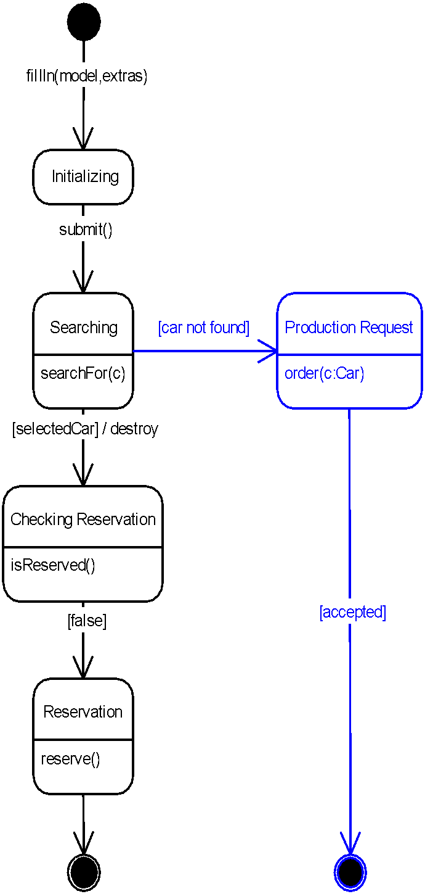
Merging Scenarios

Slide 216
Model Management Overview
A package is a general-purpose mechanism for organizing elements into groups
to manage complexity of modeling structures
A subsystem is a grouping of model elements that represents a behavioral unit in a physical (real) system.
to describe the services offered by the subsystem
to describe the interface of the subsystem
A model is a simplification of reality, an abstraction of a system, created in order to better understand the system
A partitioning of the abstraction that visualize, specify, construct and document that system
Subsystems and Models are special cases of package

Slide 217
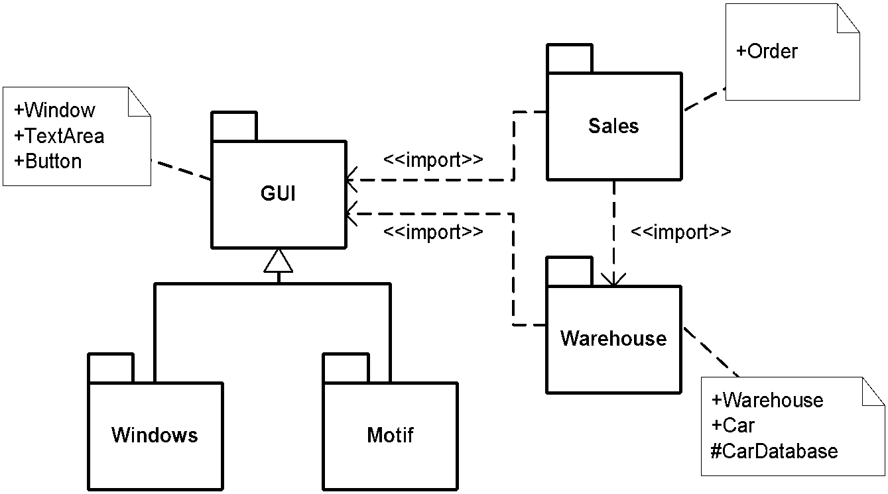
Packages
Package
Import relationship adds the contents of the target to the source namespace.
Export
Structuring of Car Ordering subsystem.

Slide 218
DESIGN

Slide 219
Design
The design model will further refine the analysis model in light of the actual implementation environment.
In analysis domain objects are the primary focus.
In design the other layers are added and refined
User Interface
Distribution
Persistence Mechanism

Slide 220
Goal of Design
Mapping of analysis models into a set of software components with precisely defined interactions based on system architecture and already existing components
Definition of the system architecture
Identifying design patterns and frameworks
Software components definition and re-use

Slide 221
Design Patterns
The design pattern concept can be viewed as an abstraction of imitating useful parts of other software products.
The design pattern is description of communicating objects and classes that are customized to solve a general design problem in a particular context.

Slide 222
Classification of Design Patterns
Creational patterns defer some part of object creation to a subclass or another object.
Structural patterns composes classes or objects.
Behavioral patterns describe algorithms or cooperation of objects.

Slide 223
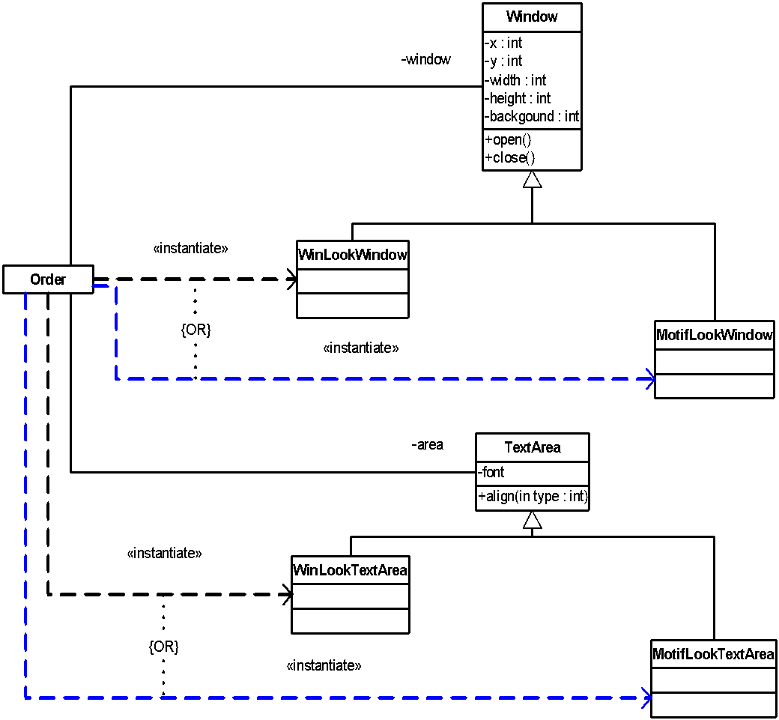
Factory – Creational Pattern
Intent - provide an interface for creating families of related objects without specifying their concrete classes.
Motivation

Slide 224

Factory - Solution
return new MotifLookWindow();
return new MotifLookTextArea();

Slide 225

Factory - Abstraction
Abstract Class: class without instances

Slide 226

Composite – Structural Pattern
Intent - compose objects into tree structures to represent part-whole hierarchies. Composite lets client treat individual objects and compositions of objects uniformly.
Motivation

Slide 227

Composite - Solution

Slide 228

Composite - Abstraction

Slide 229

Observer – Behavioral Pattern
Intent - define a one-to-many dependency between objects so that when one object changes state, all its dependents are notified and updated automatically.
Motivation

Slide 230

Observer - Solution

Slide 231

Observer – Solution (Collaboration)
Iteration
Multi-Object: a set of objects of the same class

Slide 232

Observer - Abstraction

Slide 233


Mapping into Software Components
Design Model
Implementation Environment
Analysis Model

Slide 234

Interface to Database
Adapter to relational database
Populating CarDatabase object from relational database

Slide 235
IMPLEMENTATION

Slide 236
Implementation
The goal of the implementation workflow is to flesh out the designed architecture and the system as a whole.
Implementation Model describes how elements in the design model, such as design classes, are implemented in terms of components such as a source code files, executables, and so on. The implementation model also describes how the components are organized according to the structuring and modularization mechanism available in the implementation environment and the programming language (e.g. package in Java).

Slide 237
UML Diagrams for Implementation
Component Diagram illustrates the organization and dependencies among software components – physical and replaceable part of a system that conforms to and provides the realization of a set of interfaces.
A component may be
A source code component
A binary or executable component
Others (database tables, documents) …
Deployment Diagram is refined to show the configuration of run-time processing elements and the software components, processes, and objects that execute on them.

Slide 238
Mapping
Analysis & Design
Class
Role, Type, Interface
Operation
Attribute (Class)
Attribute (instance)
Association
Dependency
Interaction between
objects
Use Case
Package/Subsystem
Source Code (Java)
Class
Interface
Method
Static variable
Instance variable
Instance variables
Local variable or argument in method or return value
Call to a method
Sequence of calls
Package

Slide 239

Design Results

Slide 240

Component Diagram: Source Code
File Component
Contained classes: Accessory
Package AirCondition
Audio
LeatherSeats
Dependency Relationship

Slide 241

Source Code: Order.java
import cars.Car;
import warehouse.Warehouse;
public class Order {
protected String customer;
protected float price;
protected Specified specified;
protected Selected selected;
protected Warehouse warehouse;
public void fillIn(String model, String extras) {
Specified specified = new Car(model, extras);
}
public boolean submit() {
// warehouse is assigned through network
selected = warehouse.searchFor(specified);
if (selected.isReserved())
return false;
selected.reserve();
return true;
}
}

Slide 242

Specified.java, Selected.java, Car.java
package cars;
public interface Specified {
String getSpec();
}
package cars;
public class Car implements Specified, Selected {
protected String model;
protected long vin;
protected boolean reserved;
public Accessory accessory;
public boolean isReserved() {
return reserved;
}
public void reserve() {
reserved = true;
}
public void assign(long num) {
vin = num;
}
public String getSpec() {
return model;
}
}
package cars;
public interface Selected {
boolean isReserved();
void reserve();
}

Slide 243

Accessory.java
package cars;
public abstract class Accessory {
public void add(Accessory a) {}
public void remove(Accessory a) {}
public Accessory getChild(int index) {
return null;
}
public abstract float getPrice();
}
class AirCondition extends Accessory {
public float getPrice() {
return 2000.0f;
}
}
// other “friend” classes
class Package extends Accessory {
private Accessory[] accessory;
public void add(Accessory a) {/*code*/}
public void remove(Accessory a) {/*code*/}
public Accessory getChild(int index) {
return accessory[index];
}
public float getPrice() {
float sum=0;
for (int i=0; i < accessory.length; i++) {
sum = sum + accessory[i].getPrice();
}
return sum;
}
}

Slide 244
Unit Tests
The purpose of performing a unit test is to test the implemented components as individual units. The following types of unit testing are done:
Specification testing, or "black-box testing" verifies the unit's externally observable behavior
Structure testing, or "white-box testing", verifies the unit's internal implementation
Integration and system tests must be done to ensure that several components behave correctly when integrated
Other tests of performance, memory usage and load

Slide 245
DEPLOYMENT

Slide 246
Deployment Model
Deployment diagram shows the configuration of run-time processing elements
The purpose of this diagram is to model the topology of hardware which the system executes.

Slide 247

Deployment Diagram
Workstation
Network
Server
Server running SQL database

Slide 248

Component Diagram: Binaries
Source Code File
Compiled (Java Bytecode) File

Slide 249

Component Diagram: Run-Time
Java Run-Time Library
Configuration Document
Compiled Source File
SQL Server
Java Virtual Machine
Relational Table

Slide 250

Refined Deployment Diagram
Warehouse Server
Showroom Server

Slide 251
TESTING

Slide 252
Test
Tests are carried out along three quality dimensions reliability, functionality, and system performance. Testing is related to all models and their diagrams!!!
The purposes of testing are:
Plan the tests required in each iteration, including integration tests and system tests. Integration tests are required for every build within the iteration, whereas system tests are required only at the end of the iteration.
Design and implement the tests by creating test cases that specify what to test, creating test procedures that specify how to perform the tests, and creating executable test components to automate the tests if possible
Perform the various tests and systematically handle the results of each test. Builds found to have defects are retested and possibly sent back to other core workflows, such as design and implementation, so that the significant defects can be fixed.

Slide 253
Verification and Validation
Verification and validation (V&V) is the term for checking processes which ensure that the software meets its requirements and that the requirements meet the needs of software procurer.
Verification: Are we building the product right? => The discovery of defects in the system.
Validation: Are we building the right product? => The assessment of whether or not the system is usable in an operational situation.

Slide 254
Static and Dynamic V&V
Static techniques are concerned with the analysis of the system representation such as the requirements, analysis, design and program listing. ST can only check the correspondence between a program and its specification (verification).
Dynamic techniques involve exercising an implementation. DT can demonstrate that the software operation is useful (validation).
Static
Verification
Requirements
Analysis
Design
Implementation
Prototype
Dynamic
Validation

Slide 255
Test Model
Test Model is a collection of:
Test cases, which specify what to test in the system.
Test procedures, which specify how to perform the test cases.
Test components, which automate the test procedures

Slide 256
Test Case
Test case specifies one way of testing the system, including what to test with which input, and under which condition to test.
The following are common test cases:
A test case that specifies how to test a use case or a specific scenario of a use case. Such a test case includes verifying the result of the interaction between the actor and the system ("black-box" test). Black-box test is the test of the externally observable behavior of the system
A test case that specifies how to test a use case realization. Such a test case includes verifying the interaction between the components implementing the use case ("white-box" test). White-box test is the test of the internal interaction between components of the system

Slide 257
Test Procedure
Test procedure specifies how to perform one or several test cases or parts of them.
Test procedures can be based on the following:
Instructions for an individual on how to perform a test case manually
Description of how to create executable test components
Specifications of how to interact with a test automation tool

Slide 258
Test Component
Test component automates one or several test procedures or parts of them. Test components are used to test the components in the implementation model by providing test inputs, controlling and monitoring the execution of the tested component, and possibly reporting the test results.
Test components can be developed using:
Scripting language or a programming language
Test automation tool

Slide 259
Deployment
The purpose of the deployment workflow is to successfully produce product releases, and deliver the software to its end users. It covers a wide range of activities including:
Producing external releases of the software.
Packaging the software.
Distributing the software.
Installing the software.
Providing help and assistance to users.
Planning and conduct of beta tests.
Migration of existing software or data.

